Slide 1

National Coordinator against Discrimination and Racism (NCDR)
Wednesday 26th of June 2024
Stakeholder Network Conference
The Right to Health of People of African Descent

Slide 2
Content
Role and task of the NCDR
Some examples
Main challenges
Health discrimination and racism discussion
Solutions and structural change
‘If you leave stones on the road, your children will trip over them’
(- Surinamese saying)

Slide 3
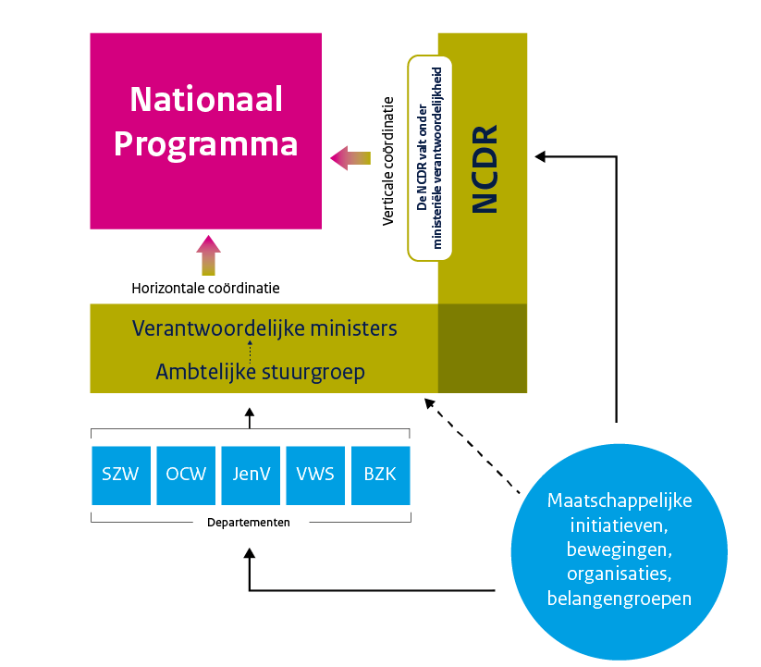
Role and task NCDR
Originated from a call from society
  BLM movement in NL
  Dutch childcare benefit scandal
Main tasks: an annual National Program and an annual National Congress
3 roles: Connector, driving force, watchdog
I take that as:
Connecting government, politics and society
And ‘getting out there’: through town hall sessions, expert meetings, conferences and an annual National Congress
In reality: pushing back against the pushback

Slide 4
Some examples I
The Dutch Association of Banks profiles on ethnicity: the NCDR has requested and received attention from the banks and from the Ministry of Finance / the Cabinet for the discriminatory effects of the Money Laundering and Terrorism Financing Act (Wwft)
https://radar.avrotros.nl/artikel/vanavond-in-radar-onveilige-reddingsvesten-en-discriminatie-bij-witwascontroles-banken-60604

Slide 5

Some examples II
Apologies of the Dutch Government and the Dutch King Willem-Alexander for the Dutch history of slavery
“the times have changed. Den keti koti, fu tru! … the chains have truly been broken,”
Dutch king apologises for country’s historical involvement in slavery | Netherlands | The Guardian

Slide 6
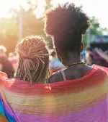
Some examples III
Pleas for the equalization of social arrangements (pension, etc.) between the European NL and the Caribbean NL,
For the realization of (the right to) the so-called transition leave for employees
for the development and application of accessibility standards in the construction of new homes
letter to the minister with a plea to include unilateral government action in the equal treatment legislation (Awgb),
attention to compliance with the implementation of the so-called rainbow ballot box agreement by the cabinet
Internship discrimination (MBO internship pact)

Slide 7
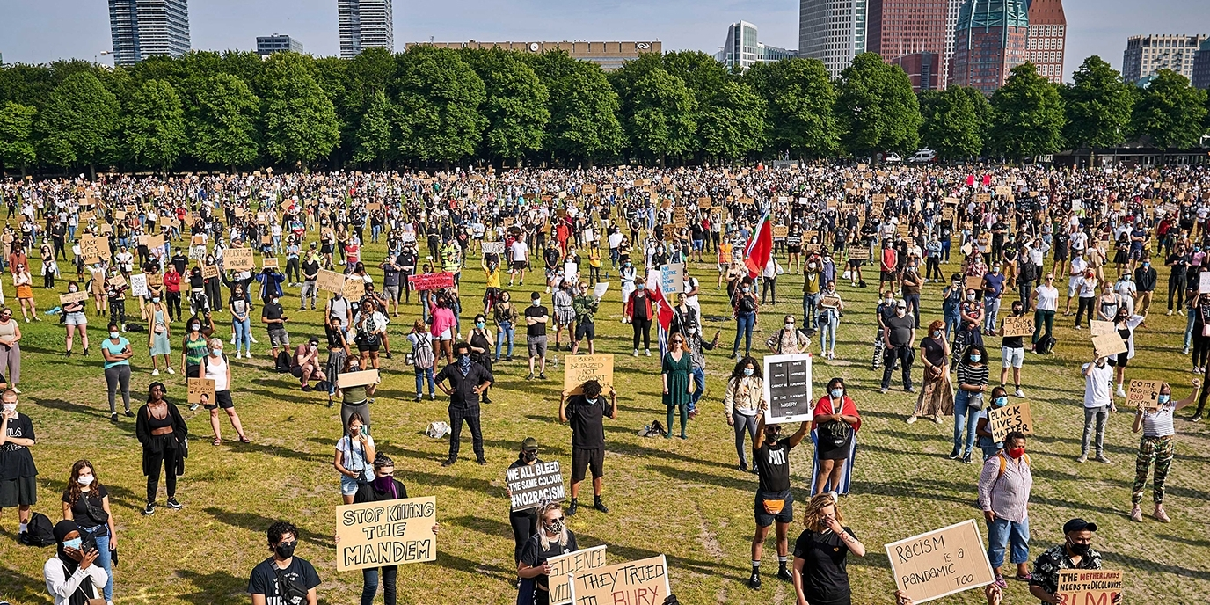
Main challenges
Everyday discrimination and racism
Institutional racism
Polarisation or: political racism

Slide 8
Everyday racism
Everyday racism occurs in the form of belittling, creating social or spatial distance, social or physical aggression, victim blaming.
Examples:
Violence based on gender, gender identity, sexual orientation or gender expression
Misogyny, also in politics
Discrimination against LGBTIQ+ people
Anti-Semitic chants in football.
More anti-Asian racism
And above all: discrimination on the basis of origin.

Slide 9
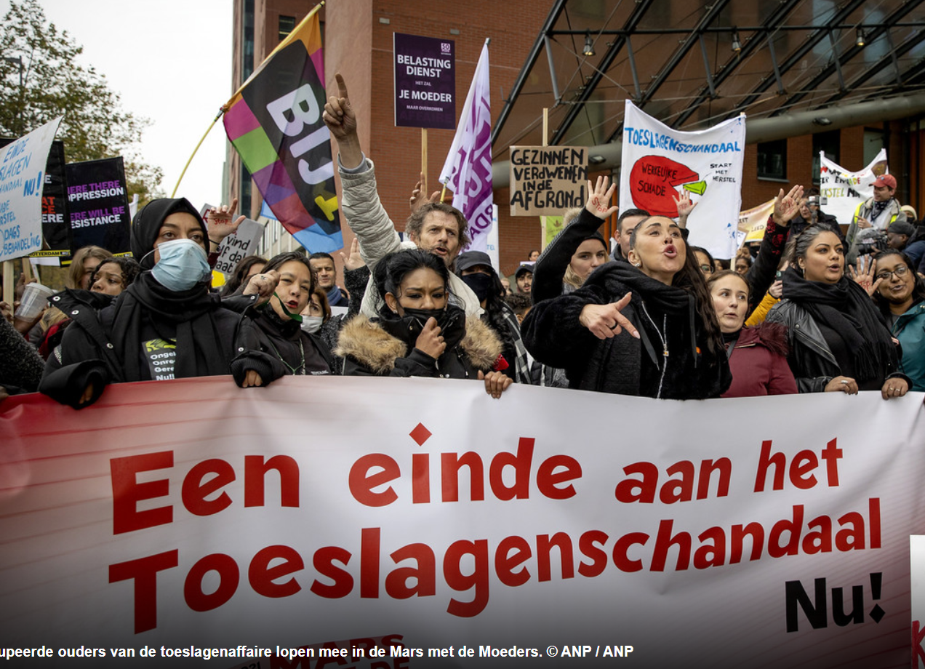
Institutional racism
Institutional racism is a social phenomenon in which processes, policies and (written and unwritten) rules of institutions have a discriminatory effect. Structurally ingrained and often not immediately recognizable. We can clearly see the distressing effects.
Examples:
Legislation, regulations and policy (Wwft, Partial Ban on Facial Covering Clothing Act)
Reports on institutional racism Min Foreign Affairs & municipalities
Discrimination in the workplace
Gender inequality in the Netherlands is large
Inaccessible buildings and online world
In (health) care

Slide 10

Polarisation or: political racism
Unwanted polarisation is very visible
Hate expressions have ample scope
Examples:
Verbal and physical violence against the LGBTQ+ community has increased
Xenophobic ideas and racism in public debate, see also migration debate
Institutionalized distrust

Slide 11
Health-discussion I: the (ab)use of outdated and unscientific distinctions
Myth of 'higher pain threshold among migrants' remains a problem in healthcare
Patients are at risk because health care still takes 'race' into account
Minister is concerned about 'race' in healthcare, but does not interfere with adjustments
Discrimination and racism are still a problem within youth care, especially for youth with a migration background
Knowledge center takes tenth of site offline: information about migrants is incorrect
Doubly disadvantaged – report on intersection of gender & disability in the Netherlands

Slide 12
Health-discussion II: the lack of inclusion in knowledge
Woman, black and ADHD: 'all white care professionals didn't understand me’
Waiting years for a diagnosis, because autism is something for white people, right? 'Autism is color blind’
Doubly disadvantaged – report on intersection of gender & disability in the Netherlands
Men and women experience physical complaints differently
Minister Dijkstra: 'Women are sent away by doctors with their pain complaints’

Slide 13
Health-discussion III: discrimination in the workforce, and consequences for a non-representative workforce
Inequality of opportunity in selection procedures limits diversity in higher education: An intersectional study of Dutch selective higher education programs (rug.nl)
Diversity in the pathway from medical student to specialist in the Netherlands: a retrospective cohort study – ScienceDirect
'Female surgeons do better work than male colleagues’
If only they thought I was the nurse
Selection for medical studies is being overhauled to increase diversity
Students with a migration background are often underestimated - also Elnaz: 'Started at pre-vocational secondary education, now a doctor’

Slide 14
Combatting discrimination and racism in health care of people of African descent
We need to combat discrimination and racism within systems and in biases of health professionals.
And we need to push for more diverse and inclusive knowledge.
At the same time there is an urgent need for more representative intersectional diversity in health care professionals.
HOW:
National Program 2023: Health care policies, protocols and underlying research need to be inclusive and effective: intersectional, specific and narrowly defined and evidence-based
We need to get rid of unscientific and biomedical irrelevant standards
Public Sector Equality Duty (example from Ireland and the UK): a big stick for health care institutions such as hospitals to achieve more diversity in the workforce

Slide 15
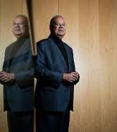
Q & A

