Slide 6
EU ANTI-RACISM ACTION PLAN
2020-2025
“The right to health of People of African Descent”
EPHA/OHCHR joint event
26 June 2024
Vanessa KABUTA, DG JUST

Slide 7
Introduction
The 1st EU anti racism action plan
adopted in September 2020
a key initiative
For this presentation,
Highlighting of some of the major accomplishments
Focus on certain actions (by Anti-Racism team)
Notes:
VK:
-who was consulted
-Main results
-attacks on Have-your-say
-

Slide 8
Features
The EU anti racism action plan
Recognition of different forms of racism, incl. anti-black racism
Recognition of structural racism
Intersectional approach to be taken
Equality to be mainstreamed into all EU policy areas (EU Pillar of Social Rights, EU4Health programme, etc.)
better use of all the existing tools and measures
Notes:
VK:
-who was consulted
-Main results
-attacks on Have-your-say
-

Slide 9
Legal protection
Racial Equality Directive (since 2000)
Non-discrimination in access to healthcare services = Basic principle of health law and of medical ethics
However, there is a need to strengthen the EU equality legal framework
Publication of EC study (Nov. 2022)
To fill this gap, adoption in May 2024 of the Directive on standards for equality bodies (2024/1499)
Useful role of Equality Bodies for victims of discrimination
Notes:
VK:
-who was consulted
-Main results
-attacks on Have-your-say
-

Slide 10
Member States
Legislation needs to be backed up by policy measures: to tackle inequalities in health on grounds of ethnicity
EU level actions encompassing initiatives in cooperation with MSs
Maximisation by MSs of the possibilities offered by EU funding programmes under the Multiannual Financial Framework (MFF) and Next Generation EU.
In the 2021-2027 programming period, EU funds promote, i.a., equal access to health- and social care for all, in particular for disadvantaged groups.
Adoption of NAPARs by the end of 2022
2021: creation of Subgroup of Member States experts
Common Guiding Principles
Monitoring checklist + reporting tool
Compendium of good or promising practices of Member States.
Stand-alone action plan for several Member States
Notes:
VK:
-who was consulted
-Main results
-attacks on Have-your-say
-

Slide 11
Member States
Joint work with MSs for making a racism-free EU a reality:
Adoption of NAPARs by the end of 2022
2021: creation of Subgroup of Member States experts
Common Guiding Principles
Monitoring checklist + reporting tool
Compendium of good or promising practices of Member States.
2024: Stand-alone action plan for several Member States
Notes:
VK:
-who was consulted
-Main results
-attacks on Have-your-say
-

Slide 12
Equality data
To address health disparities among racial and ethnic minority groups
Collect and use data to build evidence that informs decision-making and action on key social determinants of health
Aware of the practical challenges in the national contexts
Notes:
VK:
-who was consulted
-Main results
-attacks on Have-your-say
-

Slide 13
Equality data
To assist Member States in making informed policy choices:
2021: the Subgroup of Member States experts on equality data
Guidance note on the collection and use of equality data based on racial or ethnic origin.
Guidelines belonging to the tools used by the NAPARs Subgroup.
Notes:
VK:
-who was consulted
-Main results
-attacks on Have-your-say
-

Slide 14
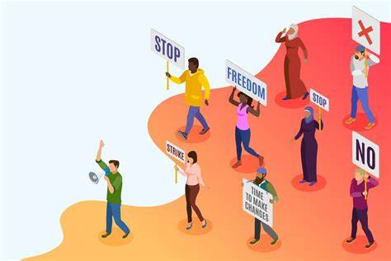
Civil society Organisations
strengthened participation of civil society organisations
reaching out to and engaging more with civil society actors on the ground. Healthcare professionals? Transcultural skills?
2021: Permanent Anti-Racism Civil Society
Forum as consultation mechanism.
Nevertheless, challenges for civic participation
Notes:
VK:
-who was consulted
-Main results
-attacks on Have-your-say
-

Slide 15
Progress report
EC reporting regularly on the implementation of the EU ARAP 2020-2025 and of its national implementation.
2023: targeted stakeholder consultation, incl. EPHA’s response.
There is a need for further progress: safe and inclusive spaces for all.
The report will provide guidance to Member States
To be published hopefully before the end of 2024.
Notes:
VK:
-who was consulted
-Main results
-attacks on Have-your-say
-

Slide 16
Conclusion
EU action in the field of public health needs to respect the competences of Member States
=> individuals may enjoy an unequal level of protection depending on their geographical location.
EC major steps in its approach to anti-racism (acknowledgement of structural racism)
Role of the IDPAD to tackle racial inequalities for Black people at EU and national level
remains committed to actively seek opportunities for dialogue,
is determined to help create a true Union of Equality
Notes:
VK:
-who was consulted
-Main results
-attacks on Have-your-say
-

Slide 17
Conclusion
EC major steps in its approach to anti-racism (acknowledgement of structural racism)
Role of the IDPAD to tackle racial inequalities for Black people at EU and national level
EC is determined to help create a true Union of Equality
Notes:
VK:
-who was consulted
-Main results
-attacks on Have-your-say
-

Slide 18
THANK YOU!
Contact: just-no-racism@ec.europa.eu
© European Union 2023
Unless otherwise noted the reuse of this presentation is authorised under the CC BY 4.0 license. For any use or reproduction of elements that are not owned by the EU, permission may need to be sought directly from the respective right holders.
Notes:
Tanja: Open public consultation, MS consultation ,

Slide 21
National Coordinator against Discrimination and Racism (NCDR)
Wednesday 26th of June 2024
Stakeholder Network Conference
The Right to Health of People of African Descent

Slide 22
Content
Role and task of the NCDR
Some examples
Main challenges
Health discrimination and racism discussion
Solutions and structural change
‘If you leave stones on the road, your children will trip over them’
(- Surinamese saying)

Slide 23
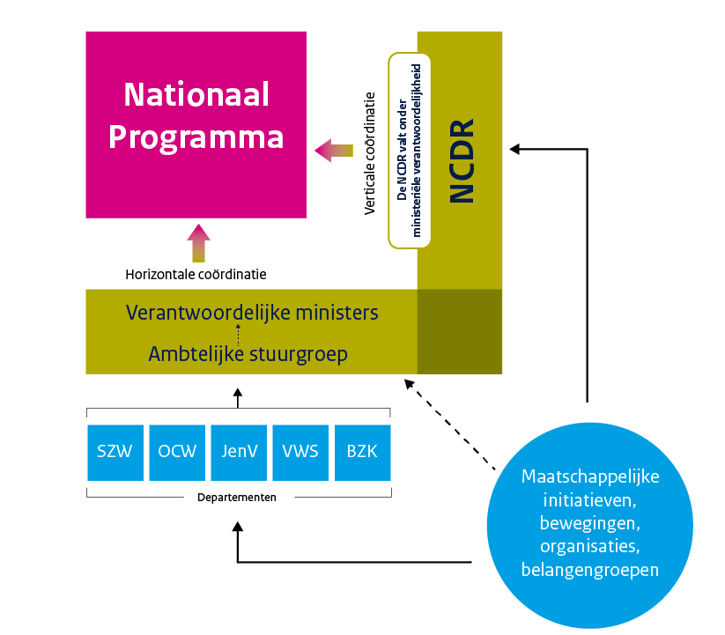
Role and task NCDR
Originated from a call from society
BLM movement in NL
Dutch childcare benefit scandal
Main tasks: an annual National Program and an annual National Congress
3 roles: Connector, driving force, watchdog
I take that as:
Connecting government, politics and society
And ‘getting out there’: through town hall sessions, expert meetings, conferences and an annual National Congress
In reality: pushing back against the pushback

Slide 24
Some examples I
The Dutch Association of Banks profiles on ethnicity: the NCDR has requested and received attention from the banks and from the Ministry of Finance / the Cabinet for the discriminatory effects of the Money Laundering and Terrorism Financing Act (Wwft)
https://radar.avrotros.nl/artikel/vanavond-in-radar-onveilige-reddingsvesten-en-discriminatie-bij-witwascontroles-banken-60604

Slide 25
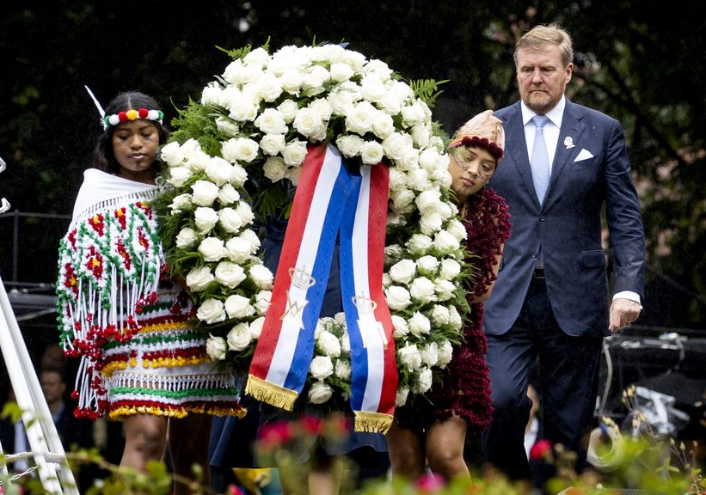
Some examples II
Apologies of the Dutch Government and the Dutch King Willem-Alexander for the Dutch history of slavery
“the times have changed. Den keti koti, fu tru! … the chains have truly been broken,”
Dutch king apologises for country’s historical involvement in slavery | Netherlands | The Guardian

Slide 26
Some examples III
Pleas for the equalization of social arrangements (pension, etc.) between the European NL and the Caribbean NL,
For the realization of (the right to) the so-called transition leave for employees
for the development and application of accessibility standards in the construction of new homes
letter to the minister with a plea to include unilateral government action in the equal treatment legislation (Awgb),
attention to compliance with the implementation of the so-called rainbow ballot box agreement by the cabinet
Internship discrimination (MBO internship pact)

Slide 27
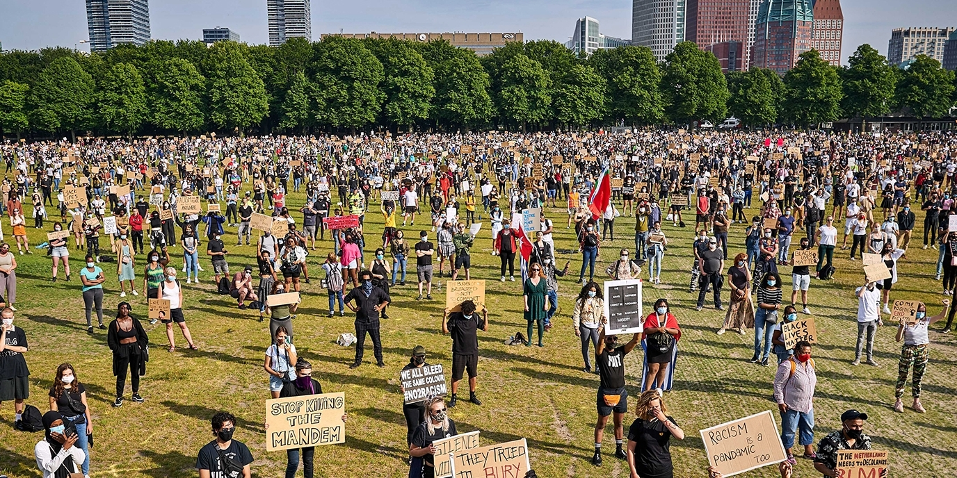
Main challenges
Everyday discrimination and racism
Institutional racism
Polarisation or: political racism

Slide 28
Everyday racism
Everyday racism occurs in the form of belittling, creating social or spatial distance, social or physical aggression, victim blaming.
Examples:
Violence based on gender, gender identity, sexual orientation or gender expression
Misogyny, also in politics
Discrimination against LGBTIQ+ people
Anti-Semitic chants in football.
More anti-Asian racism
And above all: discrimination on the basis of origin.

Slide 29
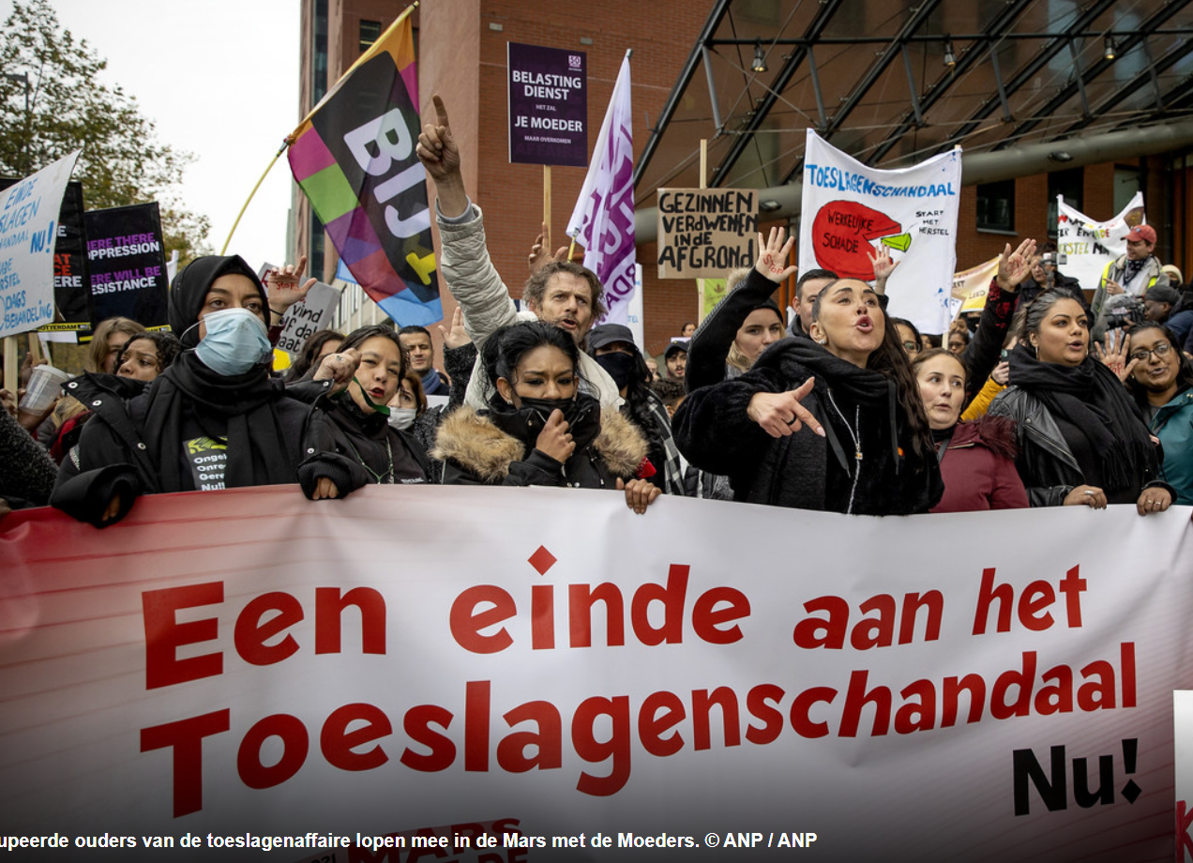
Institutional racism
Institutional racism is a social phenomenon in which processes, policies and (written and unwritten) rules of institutions have a discriminatory effect. Structurally ingrained and often not immediately recognizable. We can clearly see the distressing effects.
Examples:
Legislation, regulations and policy (Wwft, Partial Ban on Facial Covering Clothing Act)
Reports on institutional racism Min Foreign Affairs & municipalities
Discrimination in the workplace
Gender inequality in the Netherlands is large
Inaccessible buildings and online world
In (health) care

Slide 30
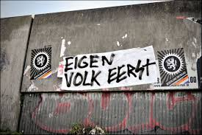
Polarisation or: political racism
Unwanted polarisation is very visible
Hate expressions have ample scope
Examples:
Verbal and physical violence against the LGBTQ+ community has increased
Xenophobic ideas and racism in public debate, see also migration debate
Institutionalized distrust

Slide 31
Health-discussion I: the (ab)use of outdated and unscientific distinctions
Myth of 'higher pain threshold among migrants' remains a problem in healthcare
Patients are at risk because health care still takes 'race' into account
Minister is concerned about 'race' in healthcare, but does not interfere with adjustments
Discrimination and racism are still a problem within youth care, especially for youth with a migration background
Knowledge center takes tenth of site offline: information about migrants is incorrect
Doubly disadvantaged – report on intersection of gender & disability in the Netherlands

Slide 32
Health-discussion II: the lack of inclusion in knowledge
Woman, black and ADHD: 'all white care professionals didn't understand me’
Waiting years for a diagnosis, because autism is something for white people, right? 'Autism is color blind’
Doubly disadvantaged – report on intersection of gender & disability in the Netherlands
Men and women experience physical complaints differently
Minister Dijkstra: 'Women are sent away by doctors with their pain complaints’

Slide 33
Health-discussion III: discrimination in the workforce, and consequences for a non-representative workforce
Inequality of opportunity in selection procedures limits diversity in higher education: An intersectional study of Dutch selective higher education programs (rug.nl)
Diversity in the pathway from medical student to specialist in the Netherlands: a retrospective cohort study – ScienceDirect
'Female surgeons do better work than male colleagues’
If only they thought I was the nurse
Selection for medical studies is being overhauled to increase diversity
Students with a migration background are often underestimated - also Elnaz: 'Started at pre-vocational secondary education, now a doctor’

Slide 34
Combatting discrimination and racism in health care of people of African descent
We need to combat discrimination and racism within systems and in biases of health professionals.
And we need to push for more diverse and inclusive knowledge.
At the same time there is an urgent need for more representative intersectional diversity in health care professionals.
HOW:
National Program 2023: Health care policies, protocols and underlying research need to be inclusive and effective: intersectional, specific and narrowly defined and evidence-based
We need to get rid of unscientific and biomedical irrelevant standards
Public Sector Equality Duty (example from Ireland and the UK): a big stick for health care institutions such as hospitals to achieve more diversity in the workforce

Slide 35
Q & A

Slide 41
DE HOFNAR PRESENT & RESEARCH
The right to health and acces to health insurance
An institutional view on two Dutch Case Studies
Presented by drs. Marciano Daans

Slide 42
DE HOFNAR PRESENT & RESEARCH
Mandate
My mandate to speak to you here arises from a shared destiny on this issue
&
My expertise as a public administration scientist on institutional tasks
Presented by drs. Marciano Daans

Slide 43
DE HOFNAR PRESENT & RESEARCH
Abstract
The Hofnar has offered customized support and assistance to both victims and their employers (the board of governors) of the Tax Office and the National Police.
Organizations, including company doctors, have no knowledge of exclusion, discrimination and racism and therefore do not know how this affects the health of employees. The result is that organizations remain reluctant to act.
A proper healthy policy for Europeans from African descent is what we need to further optimize their contribution to society.
Presented by drs. Marciano Daans

Slide 44
DE HOFNAR PRESENT & RESEARCH
Overview
01
Introduction
05
Recommendation
02
Contemporary Problems
06
Conclusion
03
Follow-Through problems
07
Spoken referents
04
Complementary perspectives
08
Reference list
Presented by drs. Marciano Daans

Slide 45
DE HOFNAR PRESENT & RESEARCH
Introduction
Too much effort is needed to convince policymakers that there is a lack of recognition, knowledge and experience about the health of Europeans of African descent.
To put it straight: There is no other way to describe the global impact of George Floyd’s murder (Daans, Cityhall Councill Rotterdam, 2021
Presented by drs. Marciano Daans

Slide 46
DE HOFNAR PRESENT & RESEARCH
Introduction
“They can deal with pain much better than other Europeans”
“Our contemporary medical knowledge carries within itself a postcolonial paradox”
European civil servants of African descent
Dutch national institutions
as CBS and SCP
Presented by drs. Marciano Daans

Slide 47
DE HOFNAR PRESENT & RESEARCH
Contemporary Problems
01
02
03
The Dutch National Tax Office Scandal 2004 - 2019
Documentary called “De Blauwe Familie” or the blue family - 2022
The Hofnar has offered customized support and assistance to both victims and their employers (the board of governors) of the Tax Office and the National Police.
Presented by drs. Marciano Daans

Slide 48
DE HOFNAR PRESENT & RESEARCH
Follow-Through Problems
Dutch Health System
Asks for more diversity
Organizations, including company doctors, have no knowledge of exclusion, discrimination and racism and therefore do not know how this affects the health of employees.
The result is that organizations remain reluctant to act.
To this day, existing institutions such as trade unions, works councils and even the internal ombudsperson cannot provide any significance in recognizing and arranging the necessary care for public servants.
All this is what we as the Hofnar Present take care of.
Presented by drs. Marciano Daans

Slide 49
DE HOFNAR PRESENT & RESEARCH
Complementary philosophies
European perspectives
African perspectives
Every context – for example of the institution, the region or the target group - requires a different approach, or plurality”
Prof. dr. Paul Frissen
“African Humanism promotes human rights such as good care for everyone regardless of gender, nationality, skin color, without losing sight of critical thinking”.
Prof. dr. S. Bosede-Oluwelu
Presented by drs. Marciano Daans

Slide 50
DE HOFNAR PRESENT & RESEARCH
Recommendation
1
2
3
Research into the long-term effects of racism and discrimination on the health of survivors
Research and specific recognition of PTSS and other trauma related illnesses as a direct consequence of prolonged racism
The inclusion of transcultural care in the basic scheme
Presented by drs. Marciano Daans

Slide 51
DE HOFNAR PRESENT & RESEARCH
Conclusion
We can stop this irrelevant paradox, only if there is a recognition for the missing knowledge and expertise by policy makers
Presented by drs. Marciano Daans

Slide 52
DE HOFNAR PRESENT & RESEARCH
Let’s start recognizing building with each other,
Thank you for your attention!
Presented by drs. Marciano Daans
www.dehofnarpresent.nl

Slide 53
DE HOFNAR PRESENT & RESEARCH
Some spoken referents
01
02
03
Mr. Yvel Blokland, Associate Advisor Safety & Transcultural between 2016 - current
Mr. L. Huyzer, Vice Chairman and Governor National Police, between 20222 and current
Mrs. M. Neervoort, Manager Youth Trauma Dutch Tax Scandal
04
05
06
More than 300 victims (14 - 30 yrs old) Dutch Tax Scandal between 2014 - current
More than 100 victims and ((managerial) employees Dutch National Police
Communityleaders, scientists, midfielorganizations, lots of governors etc...
Presented by drs. Marciano Daans

Slide 54
DE HOFNAR PRESENT & RESEARCH
Reference list
01
02
03
Prof. dr. S. Bosede-Oluwelu – Socrates and Orummila (2017). Ten Have Publishers
Prof. dr. J. Bussemaker – Zorg als sociale kwestie (2019). Leiden University of Medical Center
Dr. F. Fanon – Black skin, White Masks (2007). Grove Press / Atlantic Monthly Press
04
05
06
Prof dr. P. Frissen – De zorg vraagt om pluriformiteit (2021) Medisch Specialisten
Dr. A. Helberg-Proctor, A., M’charek, A., Meester, E. (2019). ‘Ras’ speelt ten onrechte rol in klinische besluitvorming. Medisch Contact
And others like:
Fairclough, N., Discourse and social change (1992), Polity Press
Presented by drs. Marciano Daans

Slide 56
