Slide 1


Slide 2


Slide 3
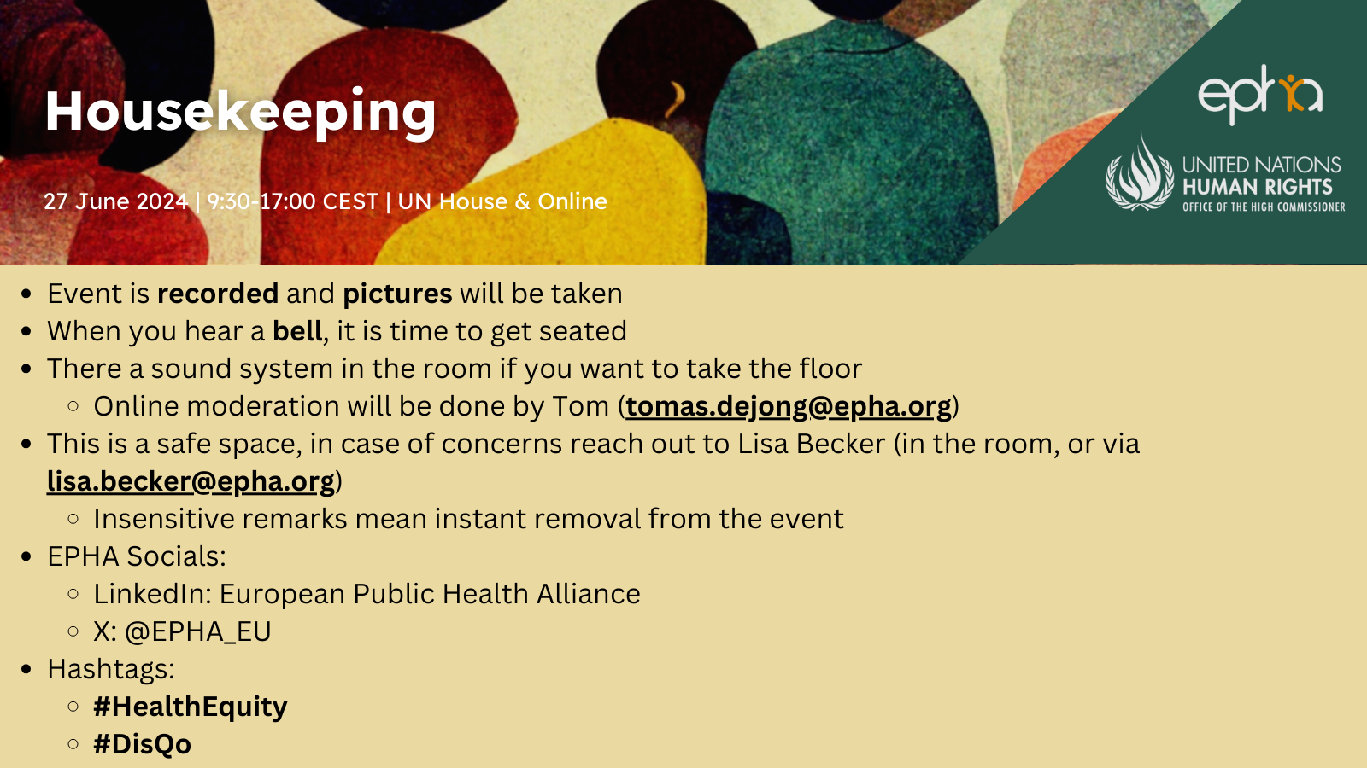

Slide 4


Slide 5
Human Rights Indicators
Tools for Measuring and Implementing Human Rights
Mila Paspalanova

Slide 6
9 core human rights treaties
Normatively binding
Established a committee of experts to monitor implementation of the treaty provisions by its States parties.
Apply without distinction of race, ethnicity, religion, sex, national origin to all people
6

Slide 7
1. ICERD International Convention on the Elimination of All Forms of Racial Discrimination (21 Dec 1965)
2. ICCPR International Covenant on Civil and Political Rights (16 Dec 1966)
3. ICESCR International Covenant on Economic, Social and Cultural Rights (16 Dec 1966)
4. CEDAW Convention on the Elimination of All Forms of Discrimination against Women (18 Dec 1979)
5. CAT Convention against Torture and Other Cruel, Inhuman or Degrading Treatment or Punishment (10 Dec 1984)
6. CRC Convention on the Rights of the Child (20 Nov 1989)
7. ICMW International Convention on the Protection of the Rights of All Migrant Workers and Members of Their Families (18 Dec 1990)
8. CPED International Convention for the Protection of All Persons from Enforced Disappearance (20 Dec 2006)
9. CRPD Convention on the Rights of Persons with Disabilities (12 Dec 2006)
7

Slide 8
Check ratification status here:
https://indicators.ohchr.org/
8

Slide 9
International Recommendations: emitted by the treaty bodies after examining country reports under treaties.
Consult here: Universal Human Rights Index
https://www.ohchr.org/en/resources/databases
9

Slide 10
International recommendations to EU member states
On RACISM:
CERD: 2478
All Treaty Bodies: 3879
All TB, SP and UPR: 8685
On DATA: 1580 from all TB, SP, UPR
10

Slide 11

“The human rights journey from standard-setting to effective implementation depends, in large measure, on the availability of appropriate tools for policy formulation and evaluation. Indicators, both quantitative and qualitative, are one such essential tool.
Navy Pillay
High Commissioner For Human Rights
11

Slide 12
Human rights indicators help…
concretize human rights standards into measurement and policy tools
strengthen transparency and accountability
implement and follow-up on recommendations from human rights mechanisms
12

Slide 13
Context & Background
OHCHR methodology for human rights indicators:
  endorsed and recommended by national, regional and international human rights mechanisms
  applied by a growing number of countries and organisations from different regions and on different human rights issues
13

Slide 14
Context & Background
OHCHR methodology for human rights indicators: HRI/MC/2008/3
  Published in 2008
  “Report on Indicators for Promoting and Monitoring the Implementation of Human Rights”
14

Slide 15
Context & Background
- 2005: group of experts (academia, international bodies, CSOs, treaty bodies, mandate holders) examines proposals on the concept, metodology and definition of illustrative indicators.
- Review by: WHO, UN HABITAT, UNESCO,UNODC, FAO, ILO, Statistical Division of the UN Economic Commission for Europe, World Bank,UN Statistical Division,
15

Slide 16
Validation of the framework
National workshops:
OPDH, legislative bodies, executive power, policy makers, agencies responsible for TB reporting, statistical bodies, UNCT, CSOs.
> 13 events in >10 countries
16

Slide 17
What is it ? What it does?
OHCHR methodology for human rights indicators provides:
a structured approach to the development and use of indicators to measure and implement human rights at international, national or local level
a framework for moving from statistics to indicators for human rights
17

Slide 18
What is it ? What it does?
Strengthen the capacity of the State to:
Monitor its level of compliance with international HR standards
Report to TB
Establish HR accountability and transparency measures
18

Slide 19
HR Indicator
Specific information on the state of an event, activity or an outcome that can be related to human rights norms and standards; that address and reflect human rights concerns and principles; and that are used to assess and monitor promotion and protection of human rights.
19

Slide 21
Criteria for the selection of indicators
Relevance and effectiveness in addressing the objective(s) for which the indicators are to be used.
Valid and reliable.
Simple, timely and few in number; based on objective information.
Suitable for temporal and spatial comparison and following relevant international statistical standards;
Amenable to disaggregation in terms of sex, age, and other vulnerable or marginalized population segments.
Respect for the right to privacy, data protection and confidentiality issues, and may, therefore, require appropriate legal and institutional standards.
21

Slide 22
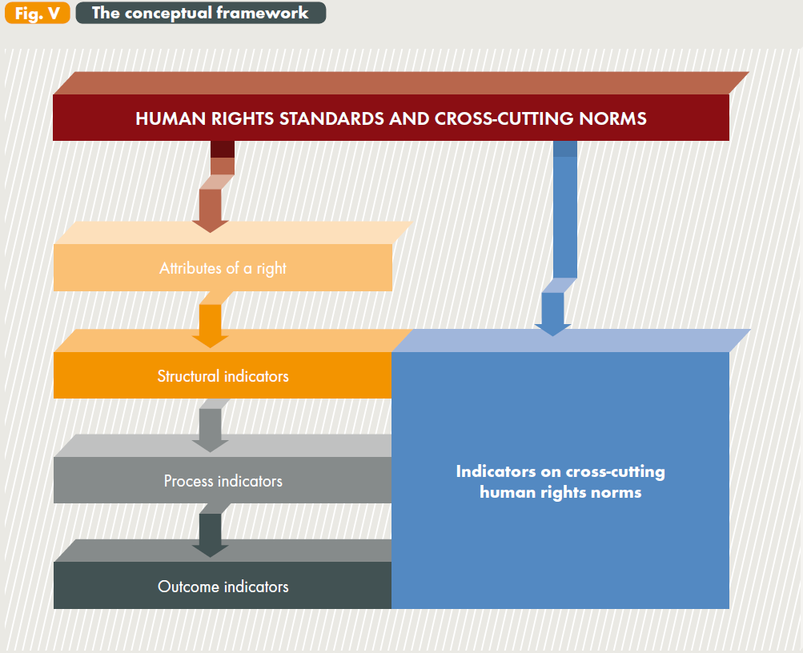
From HR standards to indicators

Slide 23
OHCHR conceptual framework
Attributes of human rights:
Exhaustive reading of the standard
Reflect essence of normative content of the right to be measured
Mutually exclusive
23

Slide 24
Illustrative indicators on the right to health (OHCHR)
 | Sexual and reproductive | Child mortality and health care | Natural and occupational environment | Prevention, treatment and control of diseases | Accessibility to facilities and essential medicines
Structural | International treaties relevant to the right to highest attainable standard of physical and mental health ratified
 | Time frame and coverage of national policy or strategy on… |  |  | Date of entry into force and coverage of national policy on mental health
Process | Proportion of received complaints on the right to health investigated and adjudicated by the national human rights institutions, human rights ombudsperson or other mechanisms and the proportion of these responded effectively by duty-bearer(s)
 | Antenatal care coverage (number of visits) | Proportion of children immunized against vaccine preventable diseases | N of cases of deterioration of water sources brought to justice | Proportion of mental health facilities inspected during reporting period | Proportion of people covered by health insurance
Outcome | Proportion of live births with low birthweight | Infant under five mortality rate | Prevalence of deaths, injuries and disabilities caused by unsafe natural and occupational environment | Death rate associated with (and prevalence of) communicable and non-communicable diseases Suicide rates Proportion of persons abusing harmful substances

Slide 25
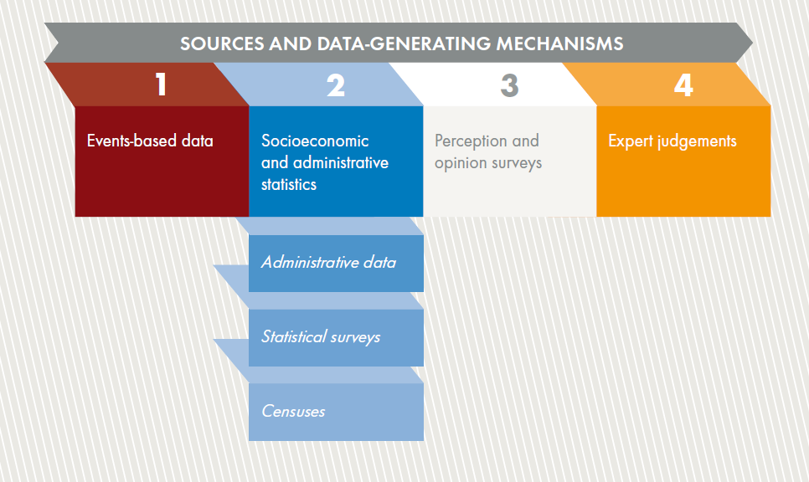

Slide 26
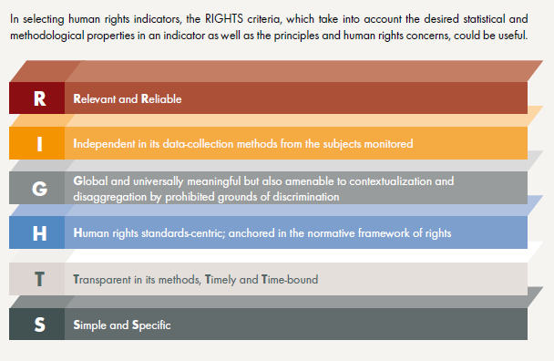
RIGHTS criteria for indicator selection

Slide 27
Operationalization at country level
Where?
  human rights reporting and follow-up on recommendations from human rights mechanisms
  national human rights action plan
  development policy / programme (human rights mainstreaming)
Who?
  government, NHRIs, CSOs,…

Slide 28
OHCHR conceptual framework
Configuration of indicators to assess steps taken by States Parties in addressing:
acceptance, intent and commitment to HR obligations (structural indicators)
efforts to transform commitments to desired results (process indicators)
results of efforts in furthering human rights (outcome indicators)
28

Slide 29
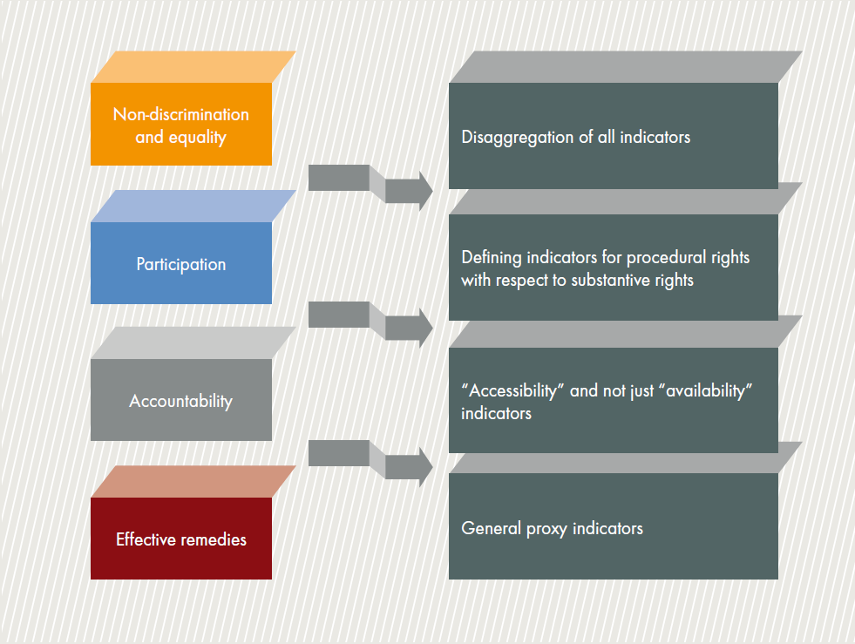
Indicators on cross-cutting human rights norms
29

Slide 30
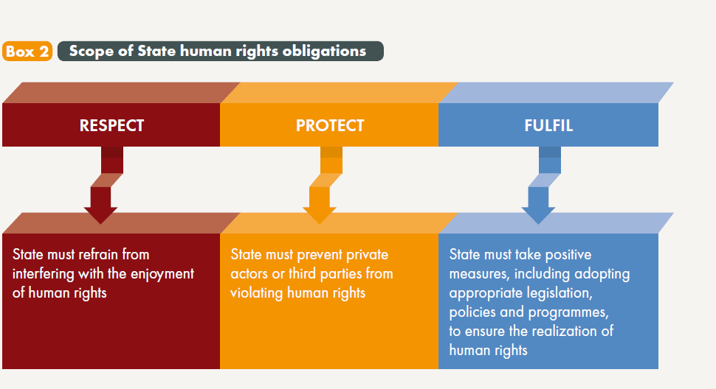

Slide 31
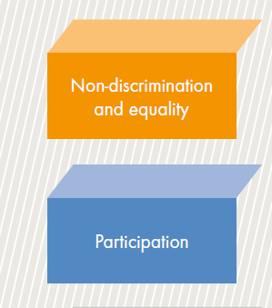
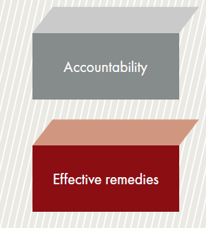
Cross cutting human rights norms

Slide 32
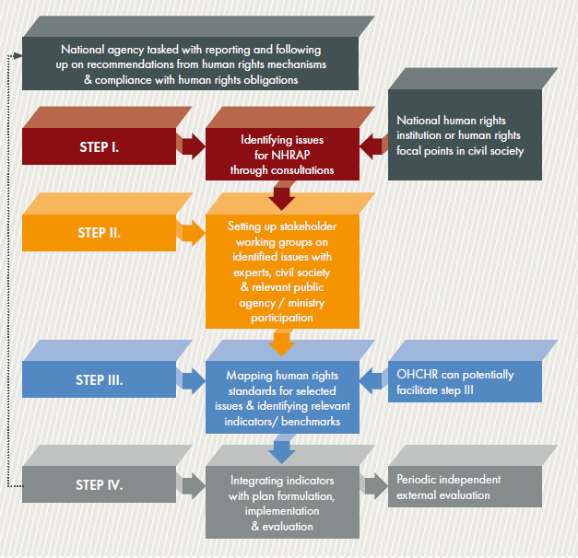
Indicators framework and National Human Rights Action Plan

Slide 33
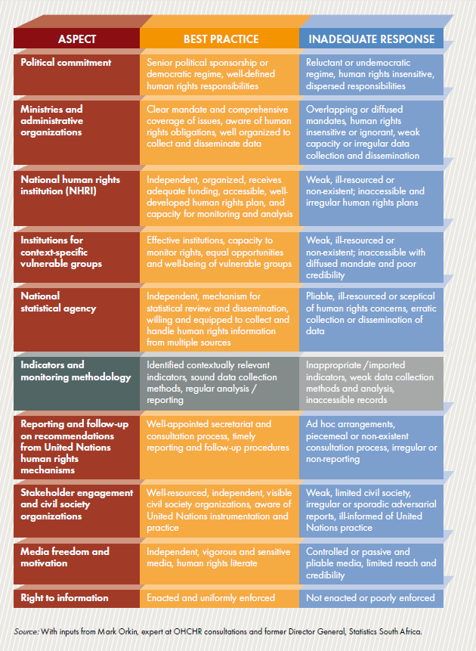
Setting up human rights monitoring systems - A reality check

Slide 34
Setting up human rights monitoring systems
Identification of monitoring stakeholders
Facilitation of country owned monitoring mechanisms
Identification of major vulnerable groups
Focus on non-discrimination and accessibility
Capacity building for data collection and disaggregation
Reporting periodicity, publication, public access to information and follow-up
34

Slide 35
FRA Being black in Europe
Non generalizable: 12 countries
Studies limited HR issues:
Harassment, violence, physical violence, police stops, discrimination awareness, education, health employment, housing, social inclusion (poverty)
3. No intersectionality
4. Perception survey; feeling discriminated
5. Difficult to interpret the findings in some cases:
35

Slide 36
FRA Being black in Europe
Risk of experiencing racist harassment decreases with age
Does it decrease or people are less prone to perceive and report it. Internalized racism. Normalized violence
Reasons for non reporting:
Contradict the findings: e.g. incident was minor
Dealt by myself: address the risks
36

Slide 37
FRA Being black in Europe
Self perceived health: 81% very good, 2% higher than general population.
Explore contradictions:
1/5 has a long standing illness; and 1/5 has long standing limitations in their usual activities.
Unmet need for medical examination: in some countries it is 50% higher than the general population
37

Slide 38


Slide 39


Slide 40


Towards quantitative equality data collection: Dutch G4 dashboard on discrimination
June 27th 2024

Slide 41

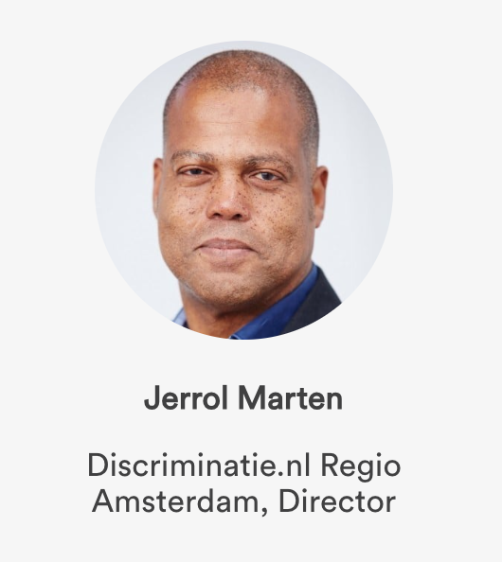
Let’s first introduce ourselves

Slide 42
Content of this presentation
Why we started this project
Goal
Approach
Stakeholders
Brief demonstration
First results
Path forward

Slide 43
Context
Every municipality in the Netherlands is legally obliged to set up an accessible, independent facility where citizens can go to with complaints or make a report about discrimination
These facilities are known as ‘Anti Discriminatie Voorzieningen’ (ADV)
One of its main tasks is to provide independent advice and support people who have experienced some sort of discrimination and in settling that complaint
These anti-discrimination agencies also register complaints and report on them, so that the government knows what is happening locally in the field of discrimination.

Slide 44
Why this project?
These ADVs have been working mostly independent
Fragmented image
  Fragmented data among the ADV’s
  Fragmented data within a single ADV
  Partners: Police, Prosecution, The Netherlands Institute for Human Rights
Very difficult to analyze
Reporting takes a lot of time
One big report per year (in PDF)

Slide 45
Goal
A clear insight into all discrimination incidents
and analyse & report on this, in 'near-real-time’
  Clear reporting: gain insight into the nature and extent of all ADVs within the Netherlands.
Consequences:
  How identify the incidents and
  Involve partners in the process

Slide 46

How: Value-driven development

Slide 47

What is the problem?
Communicate specifically target group
Bringing together different reports
Externe Excels inlezen van Partners
☺
Communicate performance/results
Communicatie effectiever maken met verhalen
User friendly
Register incidents unambiguously
Better cooperation with coalitions
Newspaper clippings: what is where in the media
Training geven
Communicate results
Do analyses
Discuss figures together
Incomplete data
Objectifying soft data
Start a conversation with the practitioner
Involve unreachable target groups
Support frontline people better
Willingness of partners to share data
Terminology: can it be compared with each other?
☹
Pivot tables are tricky. A lot of time to process data

Slide 48

Sprint Map: ADV Analyses Tool
Insight into other municipalities' numbers. Etc.
Consult
In conversation with chain partners
Reporter
I want to know “x”.
ADV / Partners
Consult
XLS
Analysis and interpretation
PDF
Analist
Communicate results
ADV - Data
#
Suplly
Anonymization while
retaining knowledge
ADV
Provide
Incident data
Partners

Slide 49
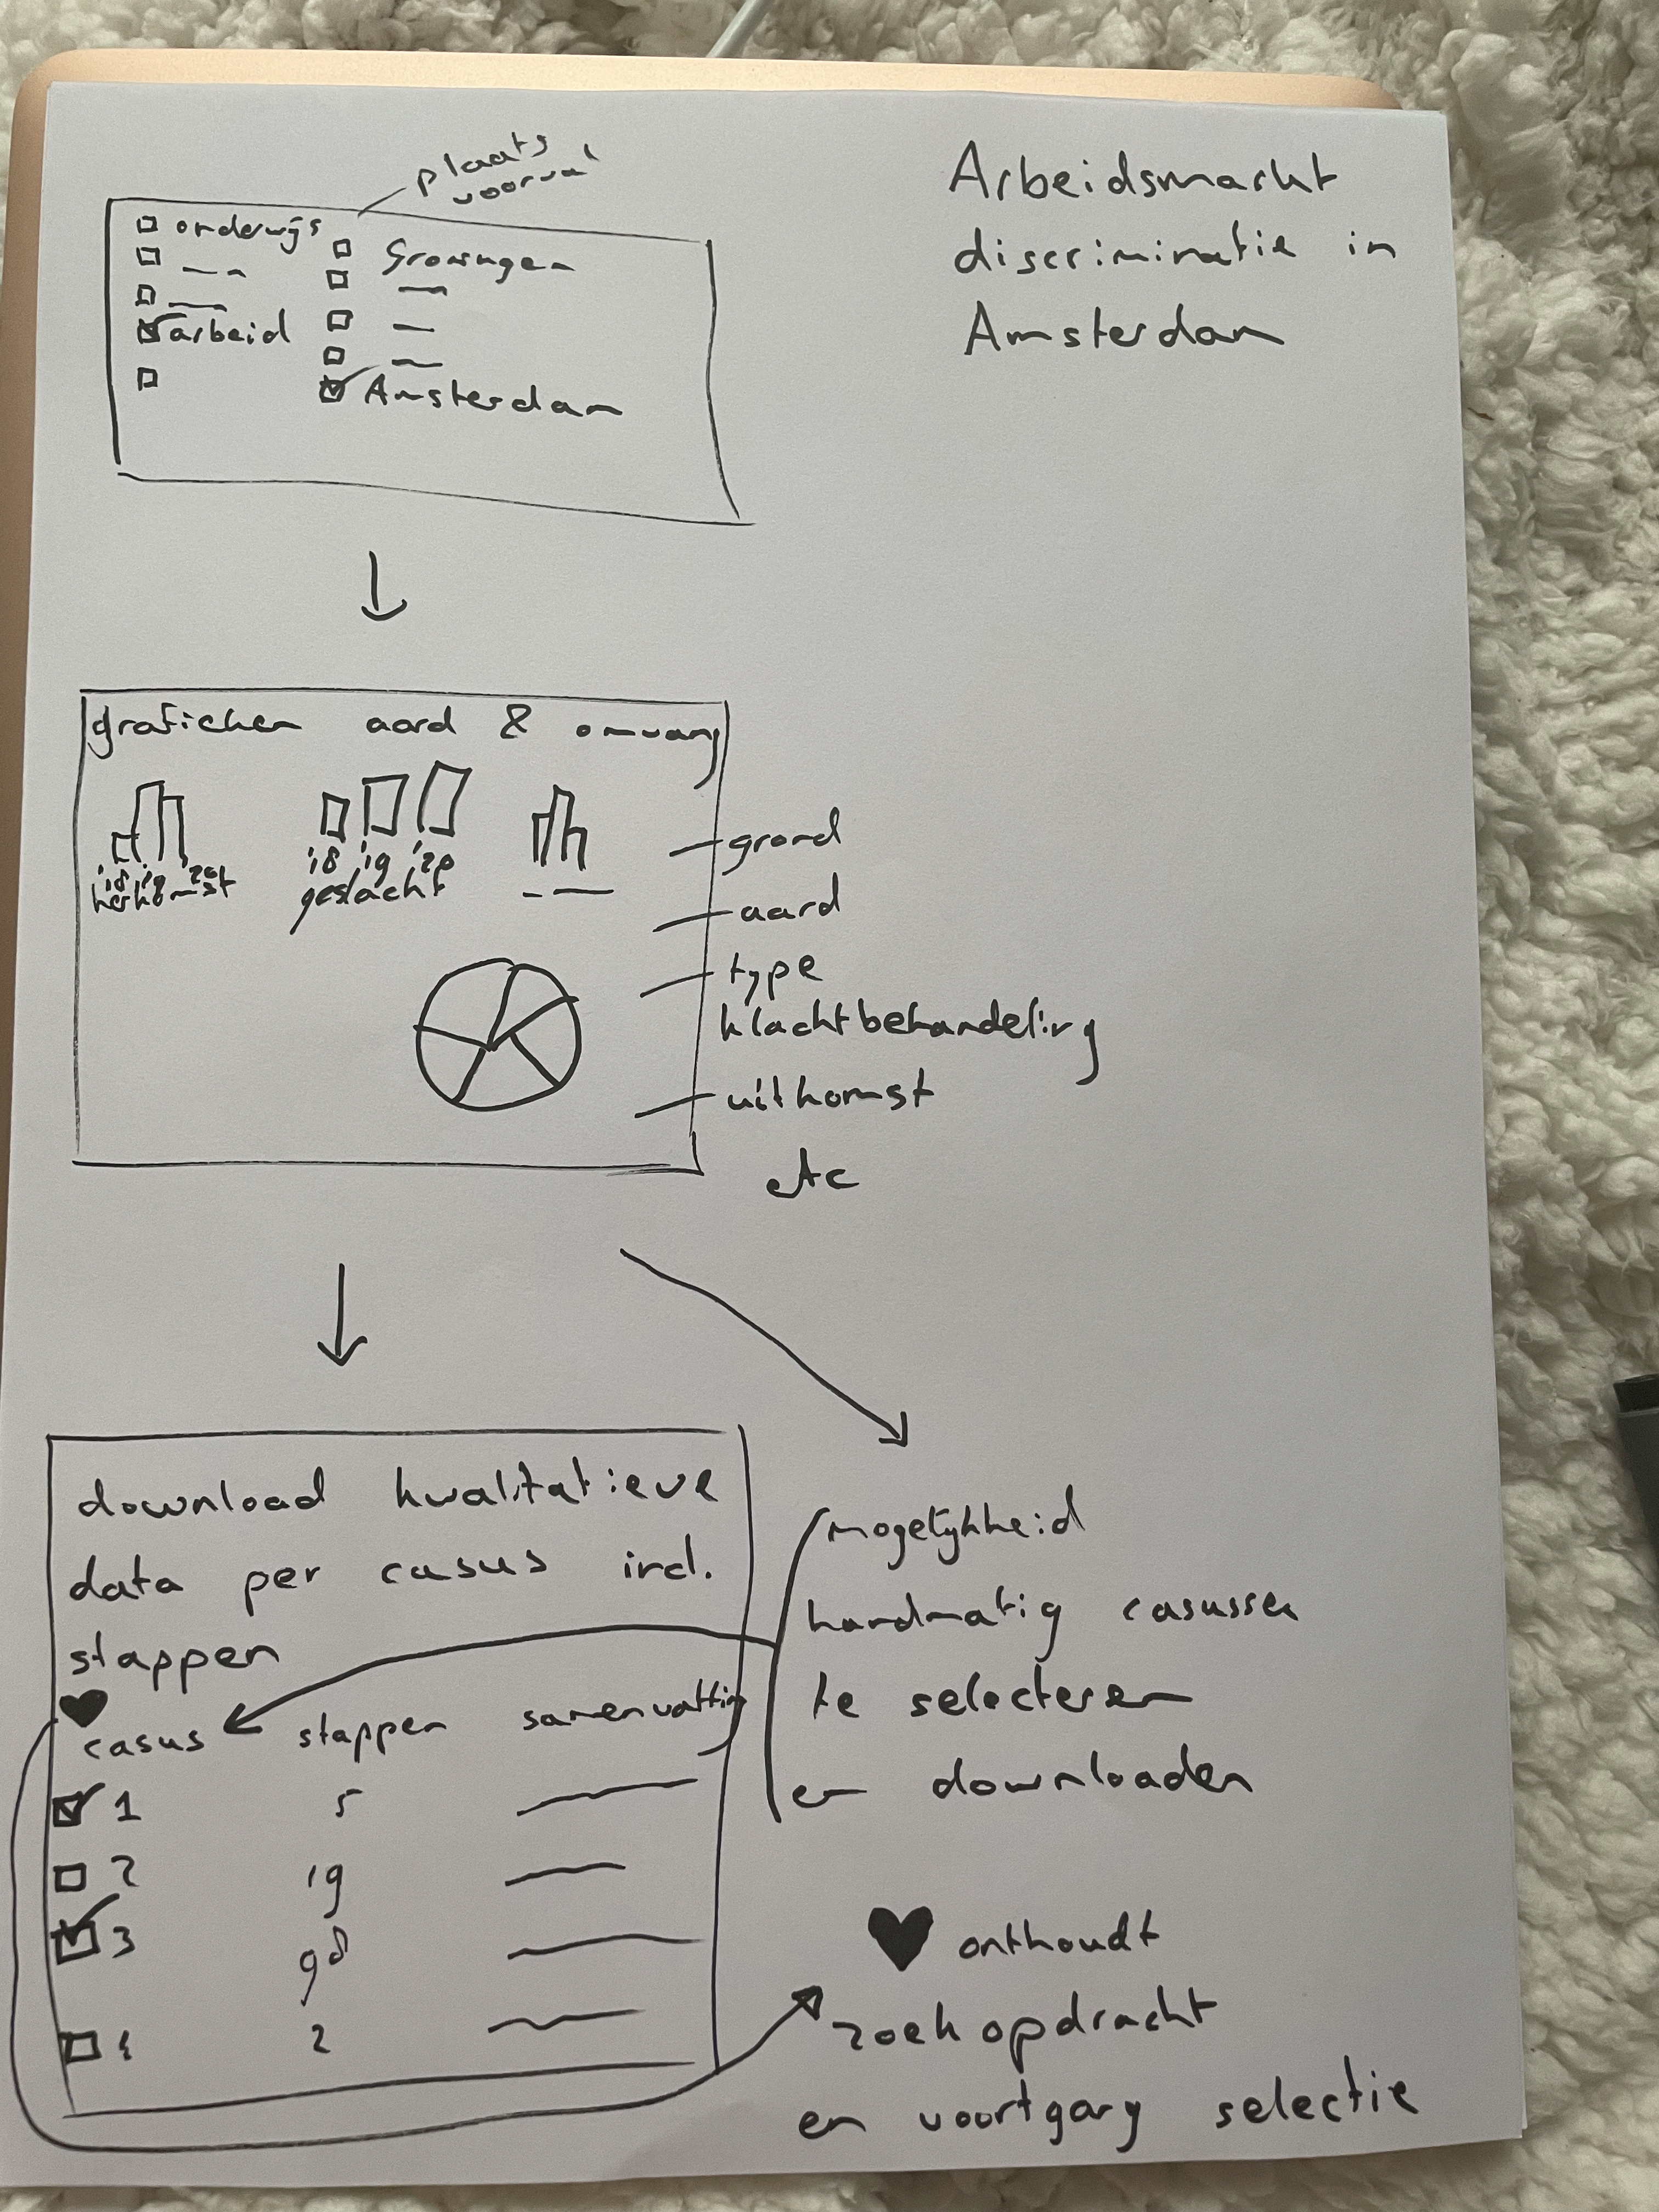
Which functions should it support, for whom
Search
Map with filters
Compare
ADV
ADV
Data analysis
Performance monitoring
Stories and case studies
Export data
Add data
Beheer
Reporting
Create custom report
Data quality control

Slide 50
Demonstration
(with screenshots…)

Slide 51
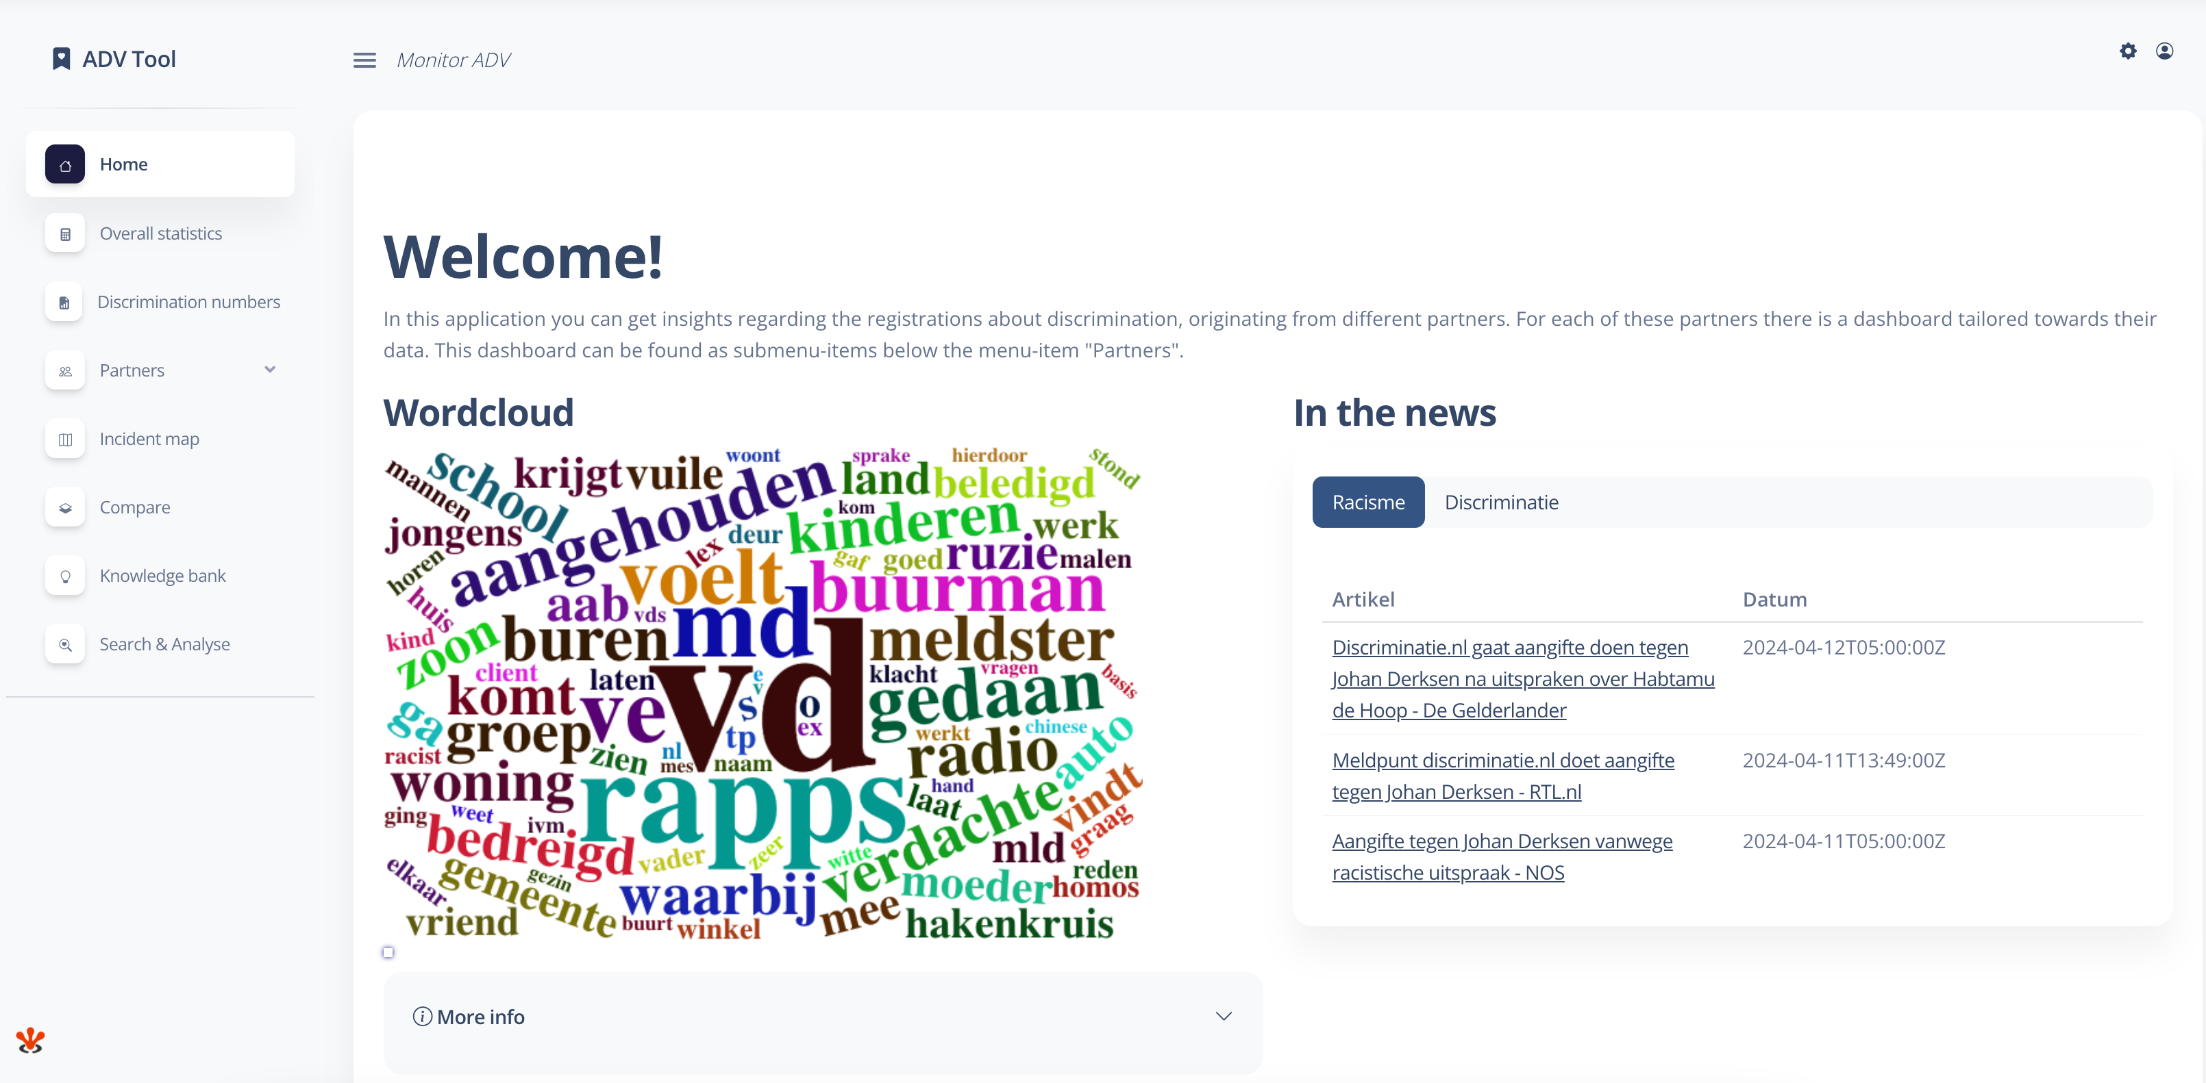
Home screen

Slide 52
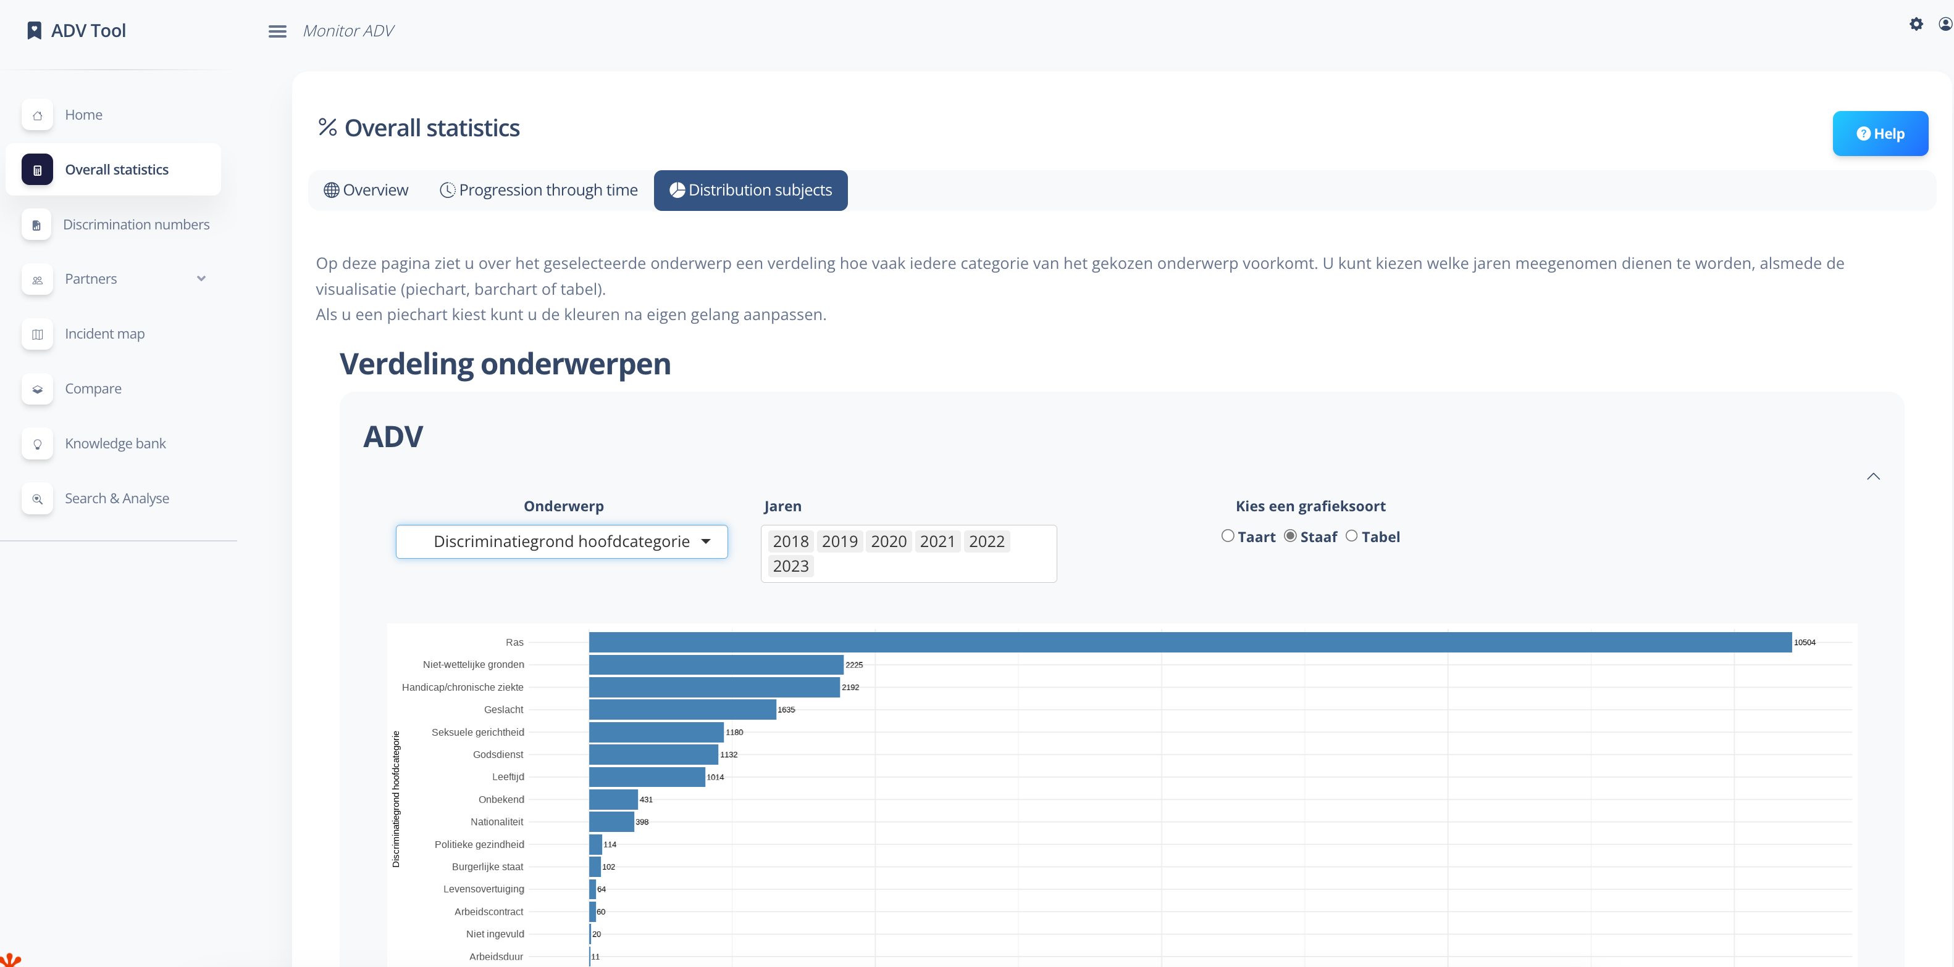
Grounds for discrimination

Slide 53
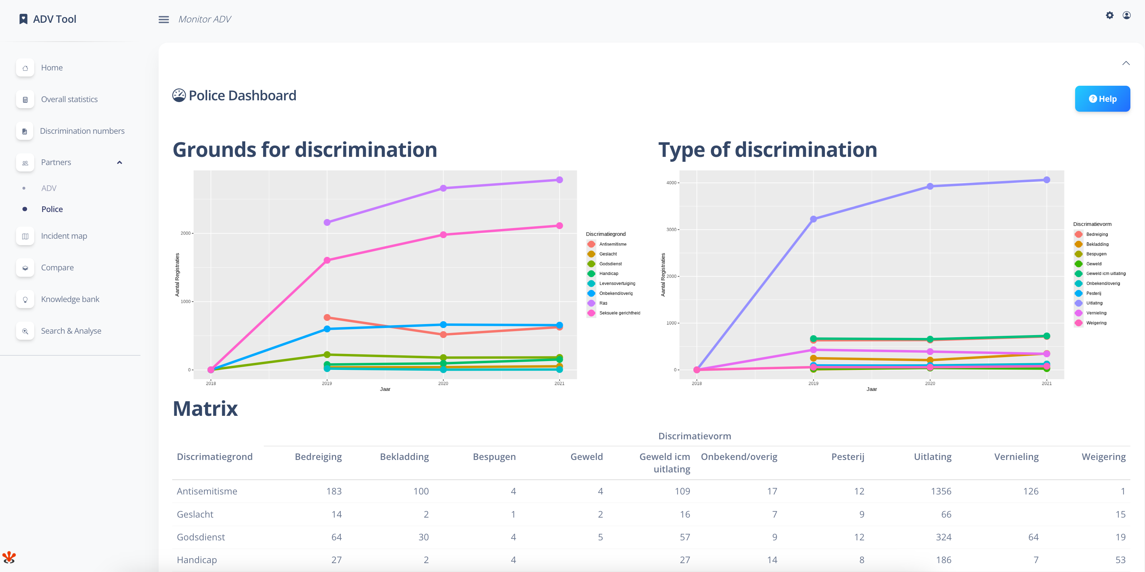
Dashboard for partners

Slide 54
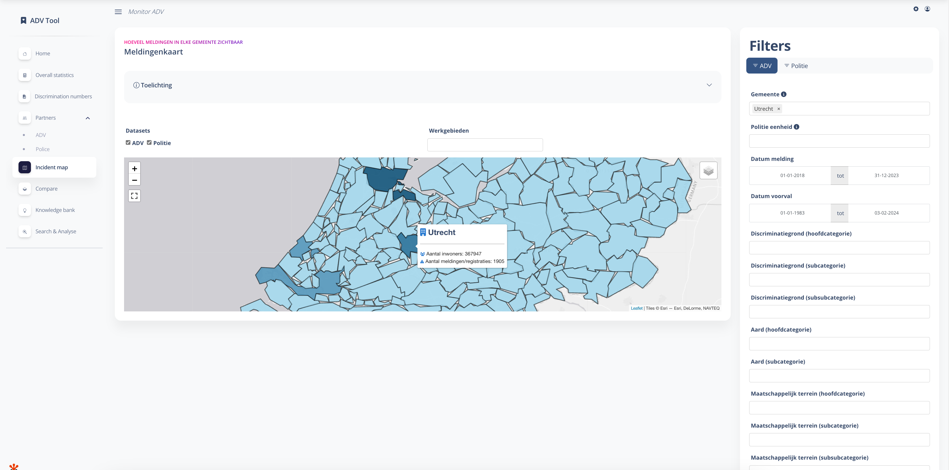
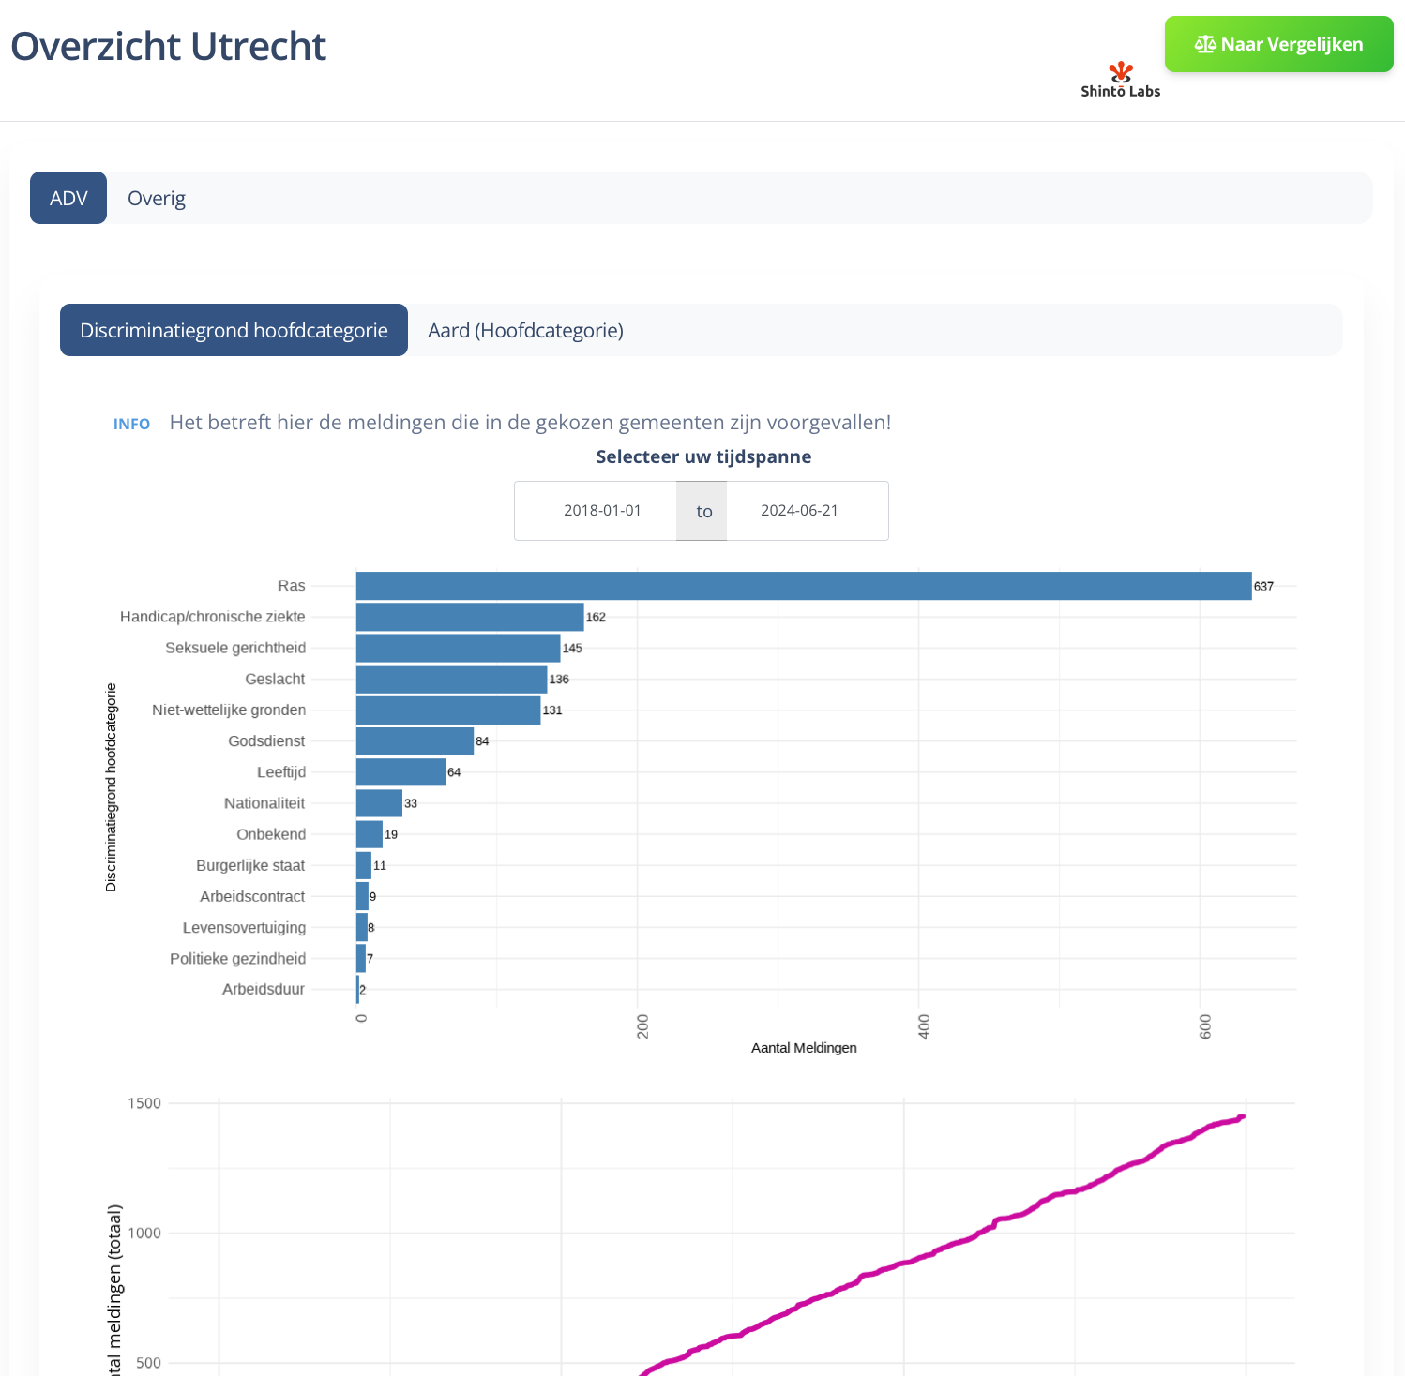
Map view

Slide 55
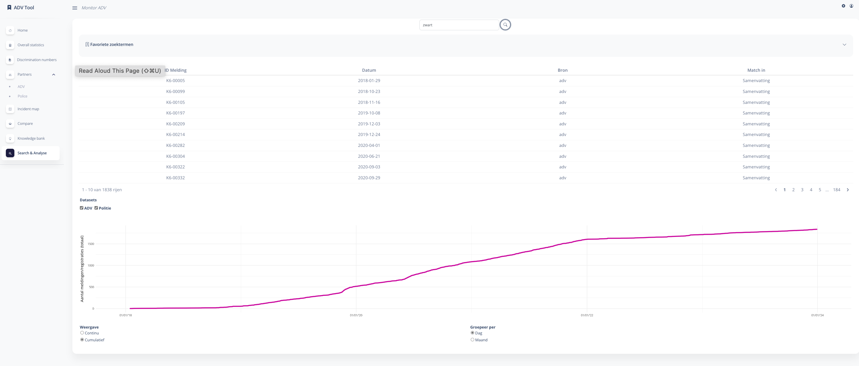
Search & Analyze: the stories behind the numbers

Slide 56
How does this analysis tool help?
Determining unequal treatment (nature and extent) and more analysis and reporting options
Comparing groups
Compiling statistics and providing insight into what is going on.
Gain insight into patterns
Create reports (including the Multi Agency Report)

Slide 57
Path forward
Phase 1 is finished:
  About to go into full production with G4
  Adding partners
    Police (automated data)
    Prosecution
    The Netherlands Institute for Human Rights
Phase 2: Scaling up nation wide in the Netherlands
Phase 3: Linking incidents with all partners without sharing sensitive data
Phase 4: Possible integration with existing EU Data and Programs

Slide 58
Available EU Data and programs
Eurobarometer Survey Series (European Commission)
  Special Eurobarometer SP535 : Discrimination in the European Union (data sets available from 27 countries in December 2023)
  Key finding: “Widespread discrimination in EU member states”
From the EU Coordinator: NAPAR
  National Action Plan and Reporting Tool
  Supporting the Development, Implementation and Monitoring of National Action Plans Against Racism
EU Anti-racism Action Plan 2020-2025
  We need to talk about racism. And we need to act. It is always possible to change direction if there is a will to do so. I am glad to live in a society that condemns racism. But we should not stop there. The motto of our European Union is: ‘United in diversity’. Our task it to live up to these words, and to fulfil their meaning (Ursula von der Leyen)

Slide 59
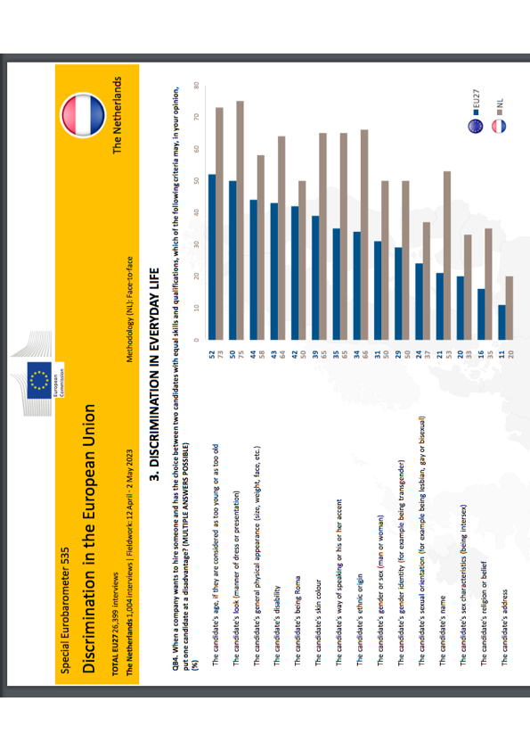
Example: Discrimination in everyday life (NL)

Slide 60
Example: Conclusion after analysis..
Name-based discrimination appears to be a significantly larger concern in the Netherlands compared to the EU average. This 32 percentage point difference (21% EU27 vs 53% NL) is striking and warrants attention.
The overall higher percentages across most categories in the Netherlands suggest a heightened awareness or concern about various forms of hiring discrimination compared to the EU average.

Slide 61
Required steps forward 2024 - 2026
Get funding to build a European data template combining “Zicht op Discriminatie” and “NAPAR” for EU wide use
Harmonize existing Eurobarometer SP535 data with “Zicht op Discriminatie” data for an integrated view.
Use the existing EU “Strategy for Data” to create a “Discrimination Data Space” which will allow for secure data exchange between member states on Discrimination
Build a near real-time EU dashboard “View on Discrimination”

Slide 62

Thank you for your attention

Slide 63
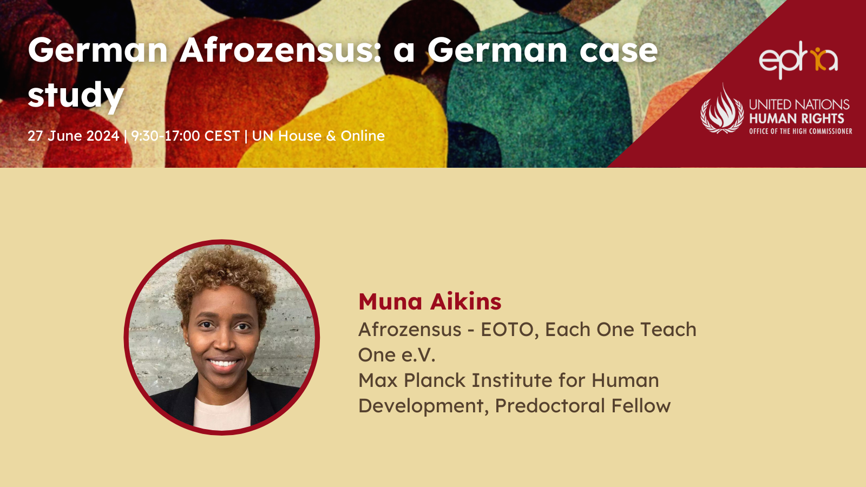

Slide 64



Slide 65


Slide 66
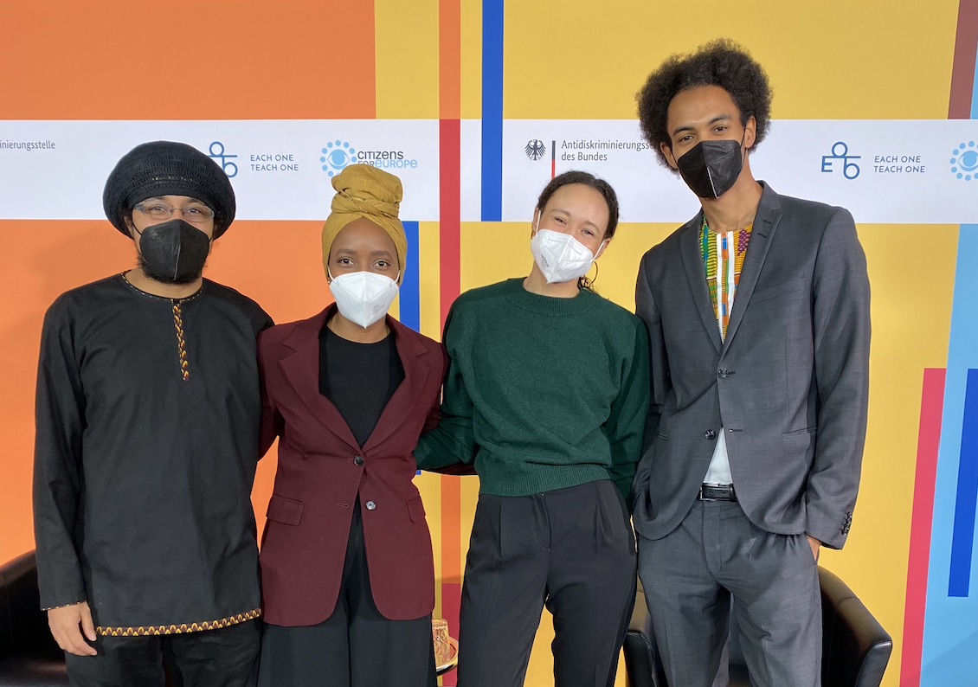

Slide 67
"Blackness is a cypher, where the conversation is intergenerational, international and interdependent."
Minna Salami (2020, p. 92)
Notes:
"It is part of the knowledge base within Black communities that anti-Black racism structures German society."
Within Germany's academia, politics, and civil society, Black perspectives remain underrepresented, leading to an absence of debates founded on Black experiences and analyses.

Slide 68
German Colonialism and Nazi eugenics:
  German colonizers committed the first genocide of the 20th (1904 - 1908)
    killed many thousand Herero and Nama in today’s Namibia
      (Olusoga & Erichsen, 2010; Zimmerer & Zelle, 2008)
  Nazi policies of “racial hygiene” systematic murder of millions of people during the Holocaust (Mohsen, 2020).
Notes:
Racism in Germany cannot be understood without reviewing the history of (European and) German colonialism in Africa (El-Tayeb, 2001; Kilomba, 2008; Oguntoye et al., 1992).
Colonial construction of supposed biological superiority of white European
German occupation of territories in Togo, Cameroon, “German East Africa”, and “German South West Africa”

Slide 69
Continuities of racialization, race-evasive discourse and science
  Race-evasive approaches displace racism temporarily, socially and geographically (Bojadžijev et al., 2017).
  Replacement of the term "Rasse” in the German constitution
  Proxies to study racism: migration background, foreigners, culture etc.
Notes:
Thus, racism is tied to the National Socialist racial policiesy, or linked to right-wing extremism or treated as a problem of former colonialist powers such as Britain and France
Racism is historically tied by scientific theories of white superiority and racial purity
German society avoided discussing race and racism for several decades
anti-Semitic and racially motivated terrorist attacks in Halle (2019), and in Hanau (2020)

Slide 70
49%
of the German population still believe in the existence of "human races”
biologistic categorizations and cultural hierarchies
(DeZIM, 2022)
Notes:
Recent surveys indicate racist beliefs persist in a significant portion of the German population, including biologistic categorizations and cultural hierarchies.
this also in the legitimization of social inequalities are found in 33–50% of the German population
Racist Realities
How does Germany deal with racism?
Racist bodies of knowledge and ideas are to some extent deeply rooted in society. 49% of respondents believe that human "races" exist, although this has long been scientifically refuted.
Every second to third person surveyed sees biological differences between people or judges people on the basis of their "culture".

Slide 71
Race is not real – but it is real in its consequences!

Slide 72

Notes:
Large-scale study that scientifically records the realities of life and (discriminatory) experiences of Black, African and Afro-diasporic people in Germany from a racism-critical perspective
Empowerment of communities: What does Black life in Germany look like and what needs must Black organizations address?
Creating a data basis for demanding political measures to combat and reduce anti-Black racism & promoting equality and empowerment
The Afrozensus shows: "The problem is structural, not personal"
Validating the individual and collective experience of Black, African and Afro-diasporic people - empowerment against the feeling of isolation

Slide 73
Communities-led Research – Afrozensus
Perspectives, Engagement and Experiences of Anti-Black Racism of Black, African and Afrodiasporic people in Germany
Filling the (quantitative) gap:
Communities-led Research Project driven by Black communities activism, social movements and scholar activism.
Do-no harm policy to approach communities
Communities data ownership and monitoring

Slide 74
Afrozensus - Approaches
Methodological approach: Numbers do not explain mechanisms:
  quantitative (online questionnaire) and
  qualitative research (focus groups and expert interviews)
Theoretical approach: critical, emancipatory, based on Black and African, feminist and decolonial approaches

Slide 75
Afrozensus - Online Survey
  Survey period: July to September 2020
  “Hidden & hard to reach”: hard to reach for whom?
  Snowball sampling by self-identification
  Cooperation and Outreach with 15 Black organizations
  well-known Black individuals and other organizations (e.g. anti-discrimination agencies)
  6.419 Participants (before data cleaning)
  5,793 Total participants
Notes:
hard to reach

Slide 76
Core principles for collecting anti-discrimination and equality data
Self-identification
Voluntary participation
Clarity about the purpose of data collection
Anonymity of respondents
Participation of representatives of marginalized groups in the process of data collection, analysis and dissemination
Intersectional analysis multiple identities, grounds for discrimination
Principle of non-harm (data must not be misused)

Slide 77

Two central premises of the Afrozensus:
Black communities are inherently diverse and simultaneously have shared experiences.
Anti-Black racism is characterized by very specific racist attributions and patterns experienced by Black, African and Afro-diasporic people in Germany and globally.

Slide 78

Diversity Dimensions
Gender identity(ies)
Sexual orientation/identities
age
Place of residence (urban/rural; east/west)
Disability and/or impairment
Religious affiliation in relation to anti-Muslim racism
Nationality
Refugee experience
Migration background
education
income
Marital status in relation to single parents
Number of African/afro-diasporic parents
Notes:
ab hier Teresa
Fett = haben die meisten signfikanten und größten gruppeninternen Unterschiede in Bezug auf Diskriminierungserfahrungen
Deniz: wenn die fett markierten signifikant sind, dann sollten sie auch oben als Gruppe einmal beannt werden, aber ihr habt behinderung ausgebldnet?

Slide 80
97,3%
experienced Anti-Black Racism
Notes:
Independent of their assessments of the general prevalence of anti-Black racism in Germany, nearly all (97.3%) of AfroCensus respondents (n = 4308) indicate that they personally experience ASR. Nearly half of respondents (42.9%) also report experiencing anti-Black racism "often" or "very often."

Slide 81
Anti-Black Racism – Patterns and Dynamics
    Processes of othering
    (Hyper-) sexualisation
    Criminalisation
    Qualifications and skills not being recognised or questioned
    De-individualisation and homogenisation
    Denial of ABR experience

Slide 82
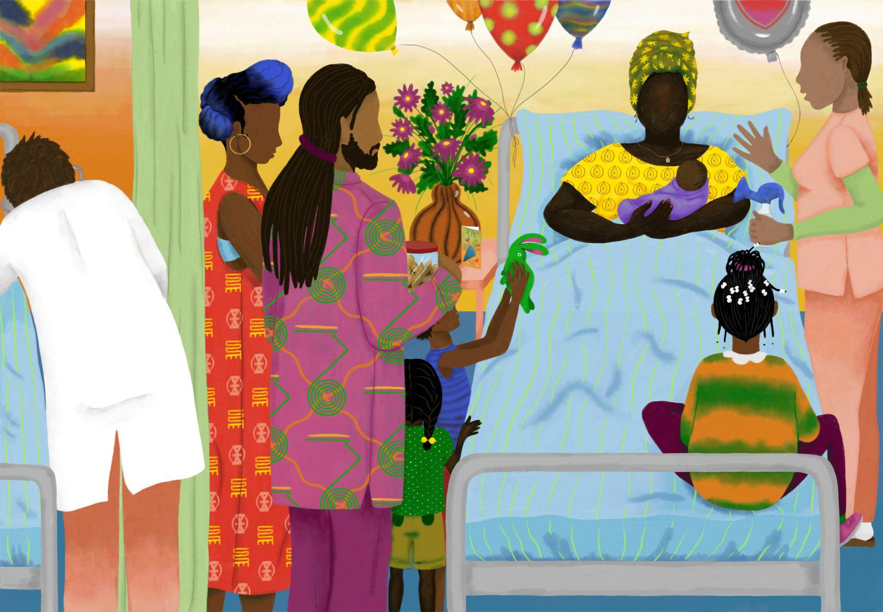

Slide 83
Dual exclusion mechanism:
  Discrimination in the utilisation of care as well as through non-utilisation, i.e. anticipated discrimination due to avoiding care structures.
  Racist aggression or violence in the provision of care exacerbates structural deficits.
Notes:
Cancellation and delay of treatment or therapy

Slide 84
Notes:
Racist Realities
How does Germany deal with racism?
Racist bodies of knowledge and ideas are to some extent deeply rooted in society. 49% of respondents believe that human "races" exist, although this has long been scientifically refuted.
Every second to third person surveyed sees biological differences between people or judges people on the basis of their "culture".

Slide 85
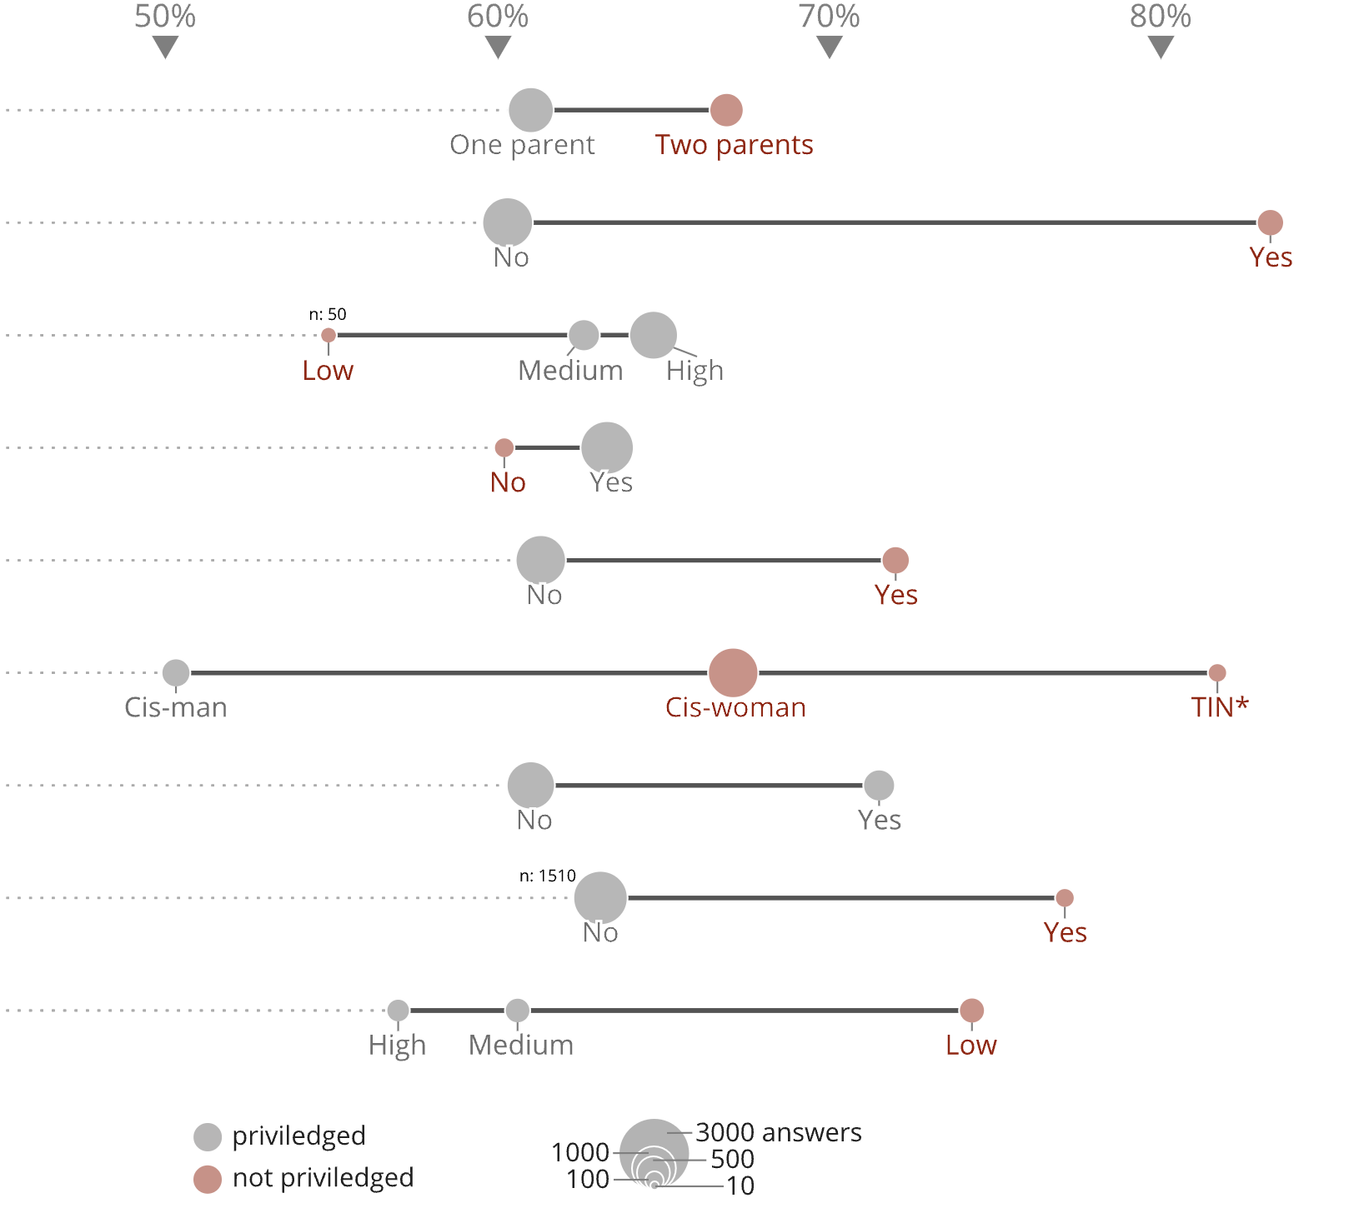
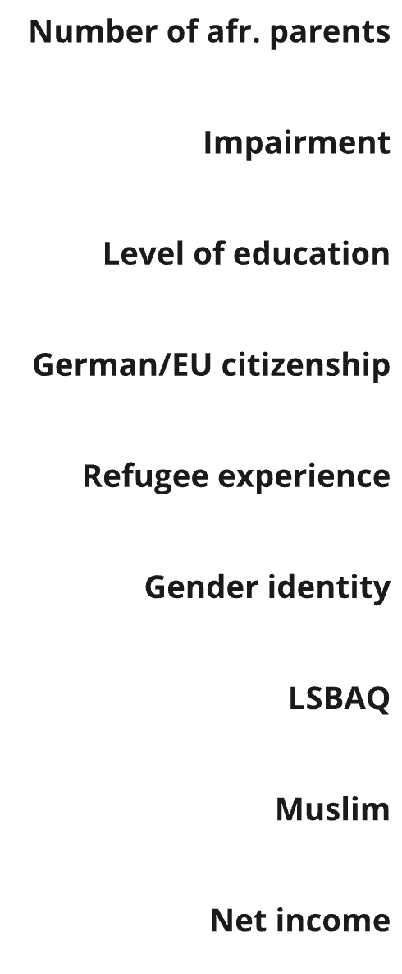

Slide 86
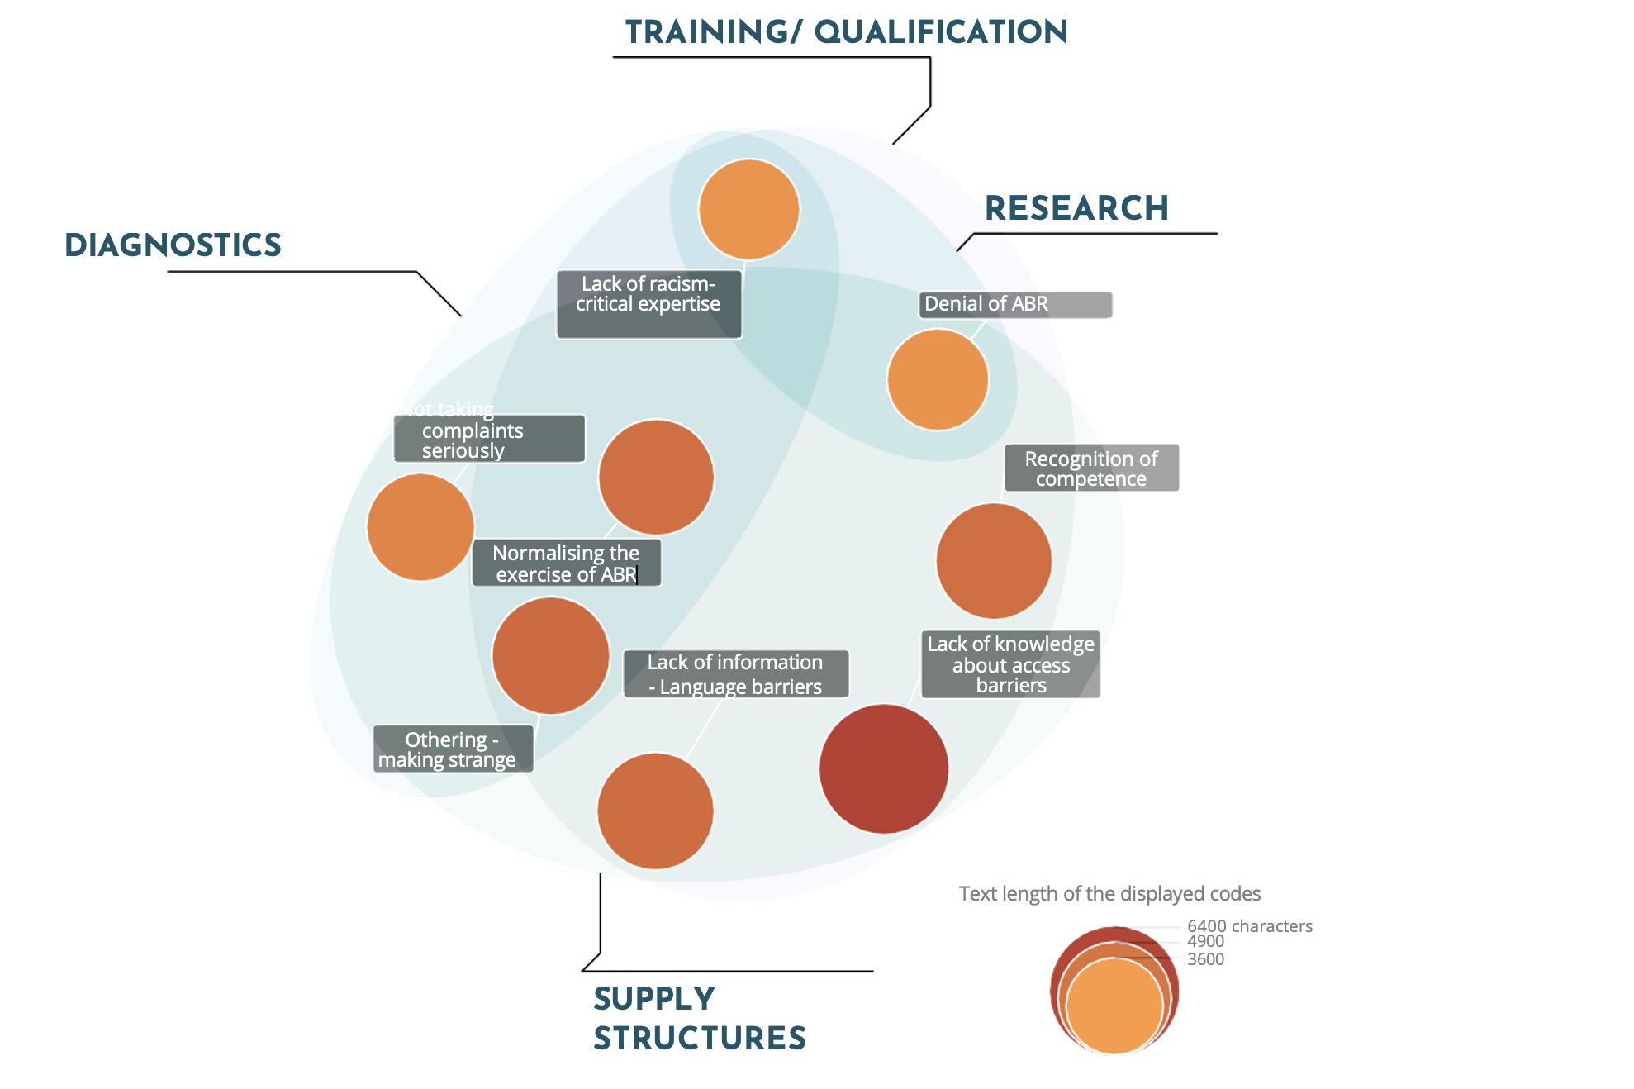
Notes:
Anti Black Racism manifests in general health care structures as well as:
diagnostics, research, and in education and qualification

Slide 87
Yes 66,7%
EOTO & CFE, CC BY-NC-ND 4.0 | afrozensus.de
Notes:
Intersections: Gender, SES, colorism

Slide 88
Yes 66,7%
EOTO & CFE, CC BY-NC-ND 4.0 | afrozensus.de

Slide 89
98%
n = 4339 assume that discrimination occurs in the area of "health and care”
14.7% state that they have avoided the health care system in the past two years for fear of discrimination.
Notes:
Cancellation and delay of treatment or therapy
Avoiding the health care system: 14.7%
worsens medical conditions
high structural access barriers and racist experiences
especially in context of psychotherapeutic and psychiatric healthcare avoidance and delay of essential treatment is being reported

Slide 90
Consequences
Discontinuation and delay of treatment or therapy
Avoidance
Mental stress / burden
Additional costs
Notes:
Demand: examine - Effects of Racism on Health!

Slide 91
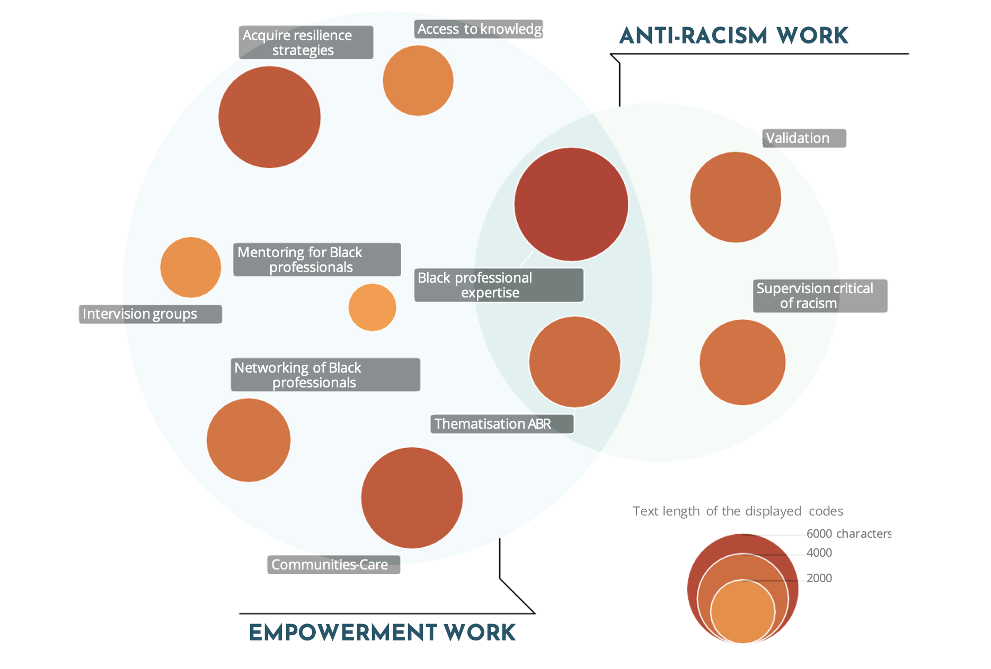
Notes:
health professionals experiences

Slide 92
Recommendations for action for politics and administration
Address racism in its structures and institutions, develop expertise that is critical of racism and understand racism as a significant factor impacting the health of Black people.
Psychotherapeutic care: special needs / therapists with racism-critical skills and competencies
Systematically promote access to medical training specifically for black people
Evaluation of current treatment concepts and training programs
Notes:
Demand: examine - Effects of Racism on Health!

Slide 93
Recommendations for action for Black, African and Afro-diasporic communities
Sharing knowledge: too few self-organized spaces in which Black, African and Afro-diasporic communities and self-organizations can share information about navigating the health care system.
Complaints mechanisms: Black individuals and associations have so far made too little use of official complaints mechanisms
  → demands and needs to the medical associations and psychotherapeutic institutions.
Notes:
Demand: examine - Effects of Racism on Health!

Slide 94
Research on Racism and Health in Germany
Study racial disparities: German health care system and effects of racism on health.
Race-evasive approaches are dominant
History of medical research is based on violence - historical events have had a lasting impact on marginalized communities
German Science lacks both lack of differentiated concepts and data
Examining race and the processes of racialization and its effects on health
Notes:
racial essentialism – scienfic racism

Slide 95

"Black empowerment, enlightenment, networking, education, new terminologies that can give a name to what is experienced and thus make it real and also tangible for others.”
______
"Indeed, there is knowledge. Indeed, there is experience."
"[This knowledge] however, is not being recognised to matter."
Notes:
knowledge mobilisation

Slide 96

EOTO & CFE, CC BY-NC-ND 4.0 | afrozensus.de

Slide 97
Self-positioning
Notes:
Resistance and sources of empowerment

Slide 98
"Anti-Black Racism (ABR) is a specific form of racism and has been a tradition in Europe and Germany since the time of enslavement. ABR is a specific degradation, dehumanisation and racist discrimination of Black people of African descent. Regardless of the reality of discrimination/hierarchisation according to 'skin tone' (colourism), ABR cannot be reduced to discrimination based on 'skin colour', as specific dynamics exist in anti-Black discrimination, and these are experienced by people of different 'skin tones'."

Slide 99


Slide 100
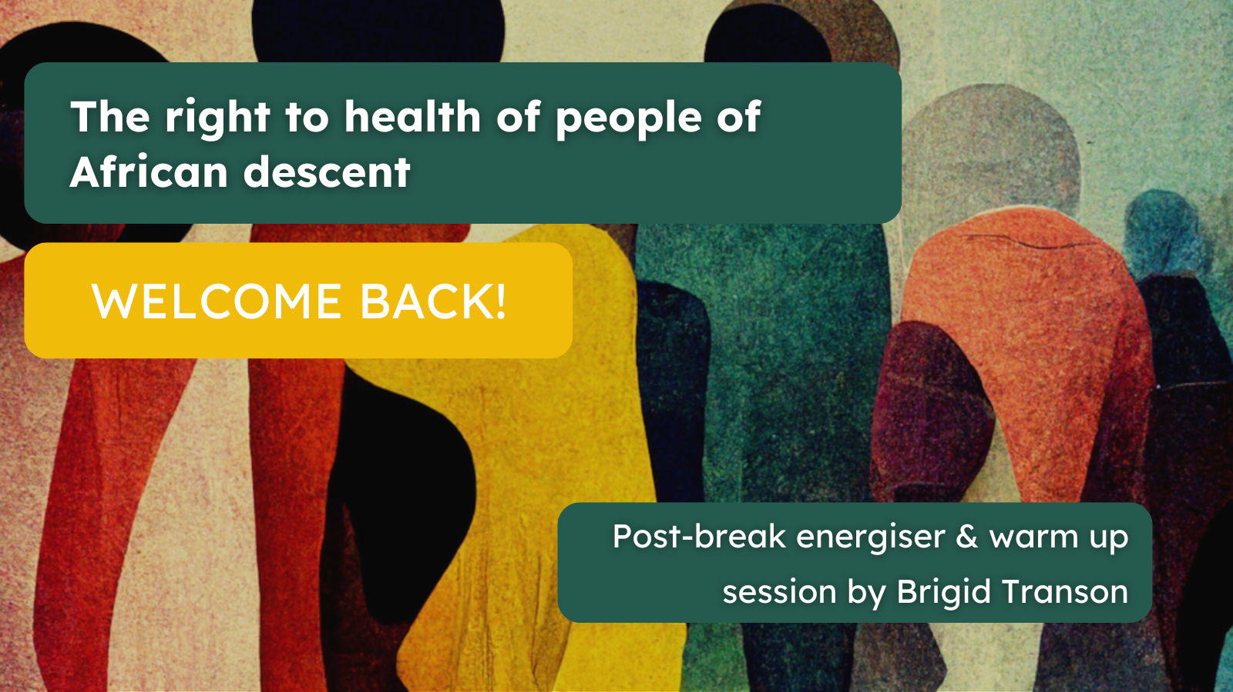

Slide 101


Slide 102


Slide 103


Slide 104


Slide 105


