Slide 1

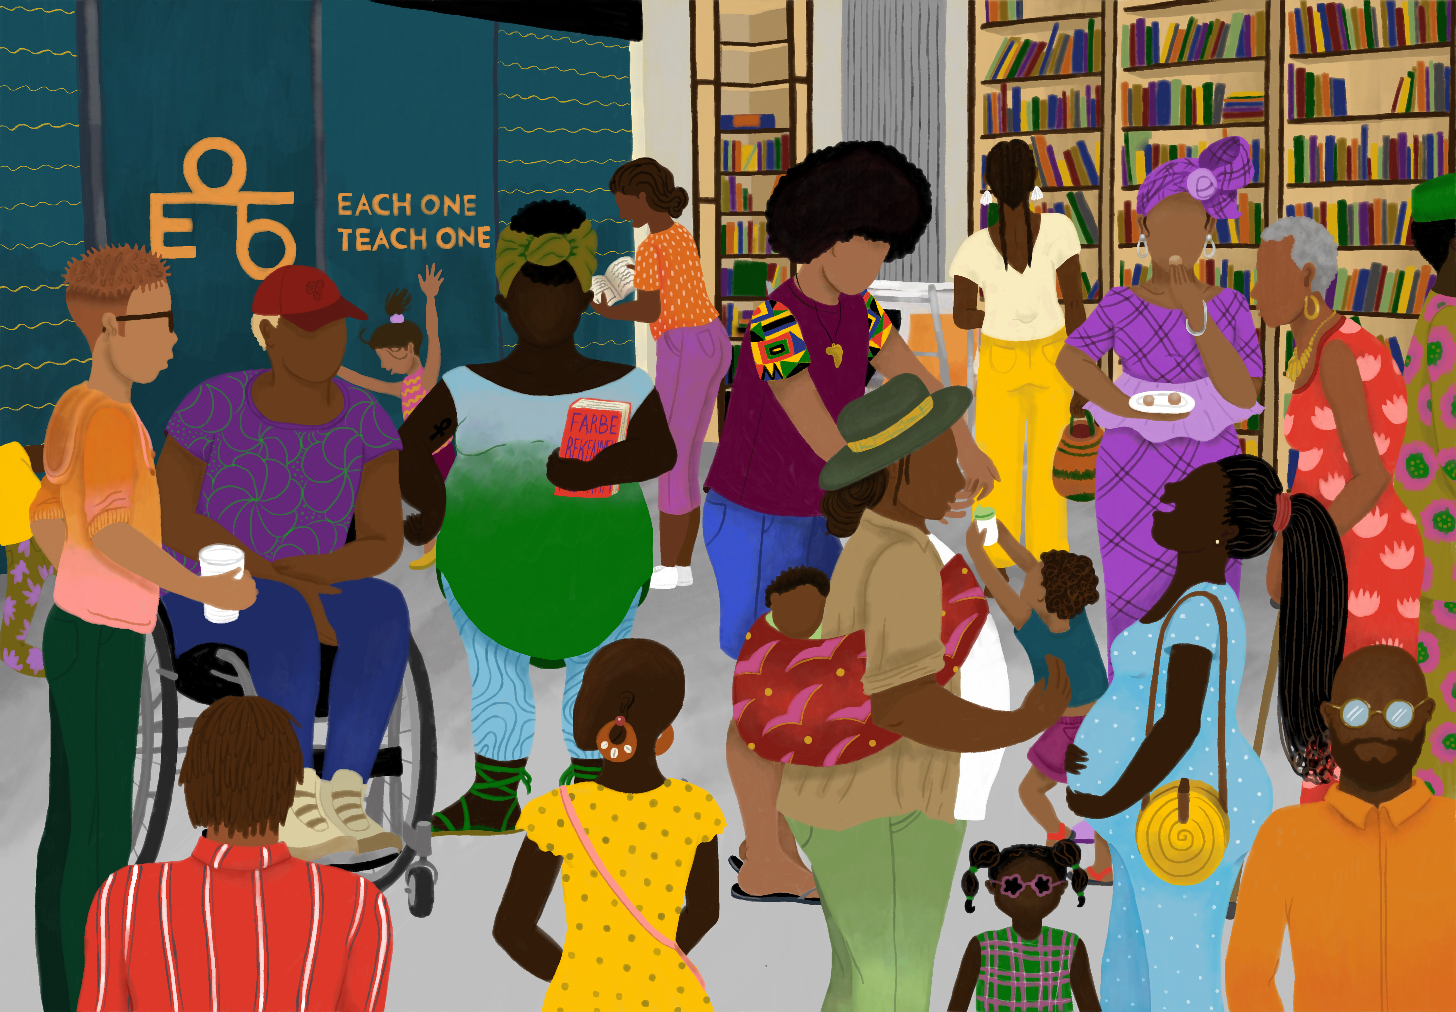

Slide 2
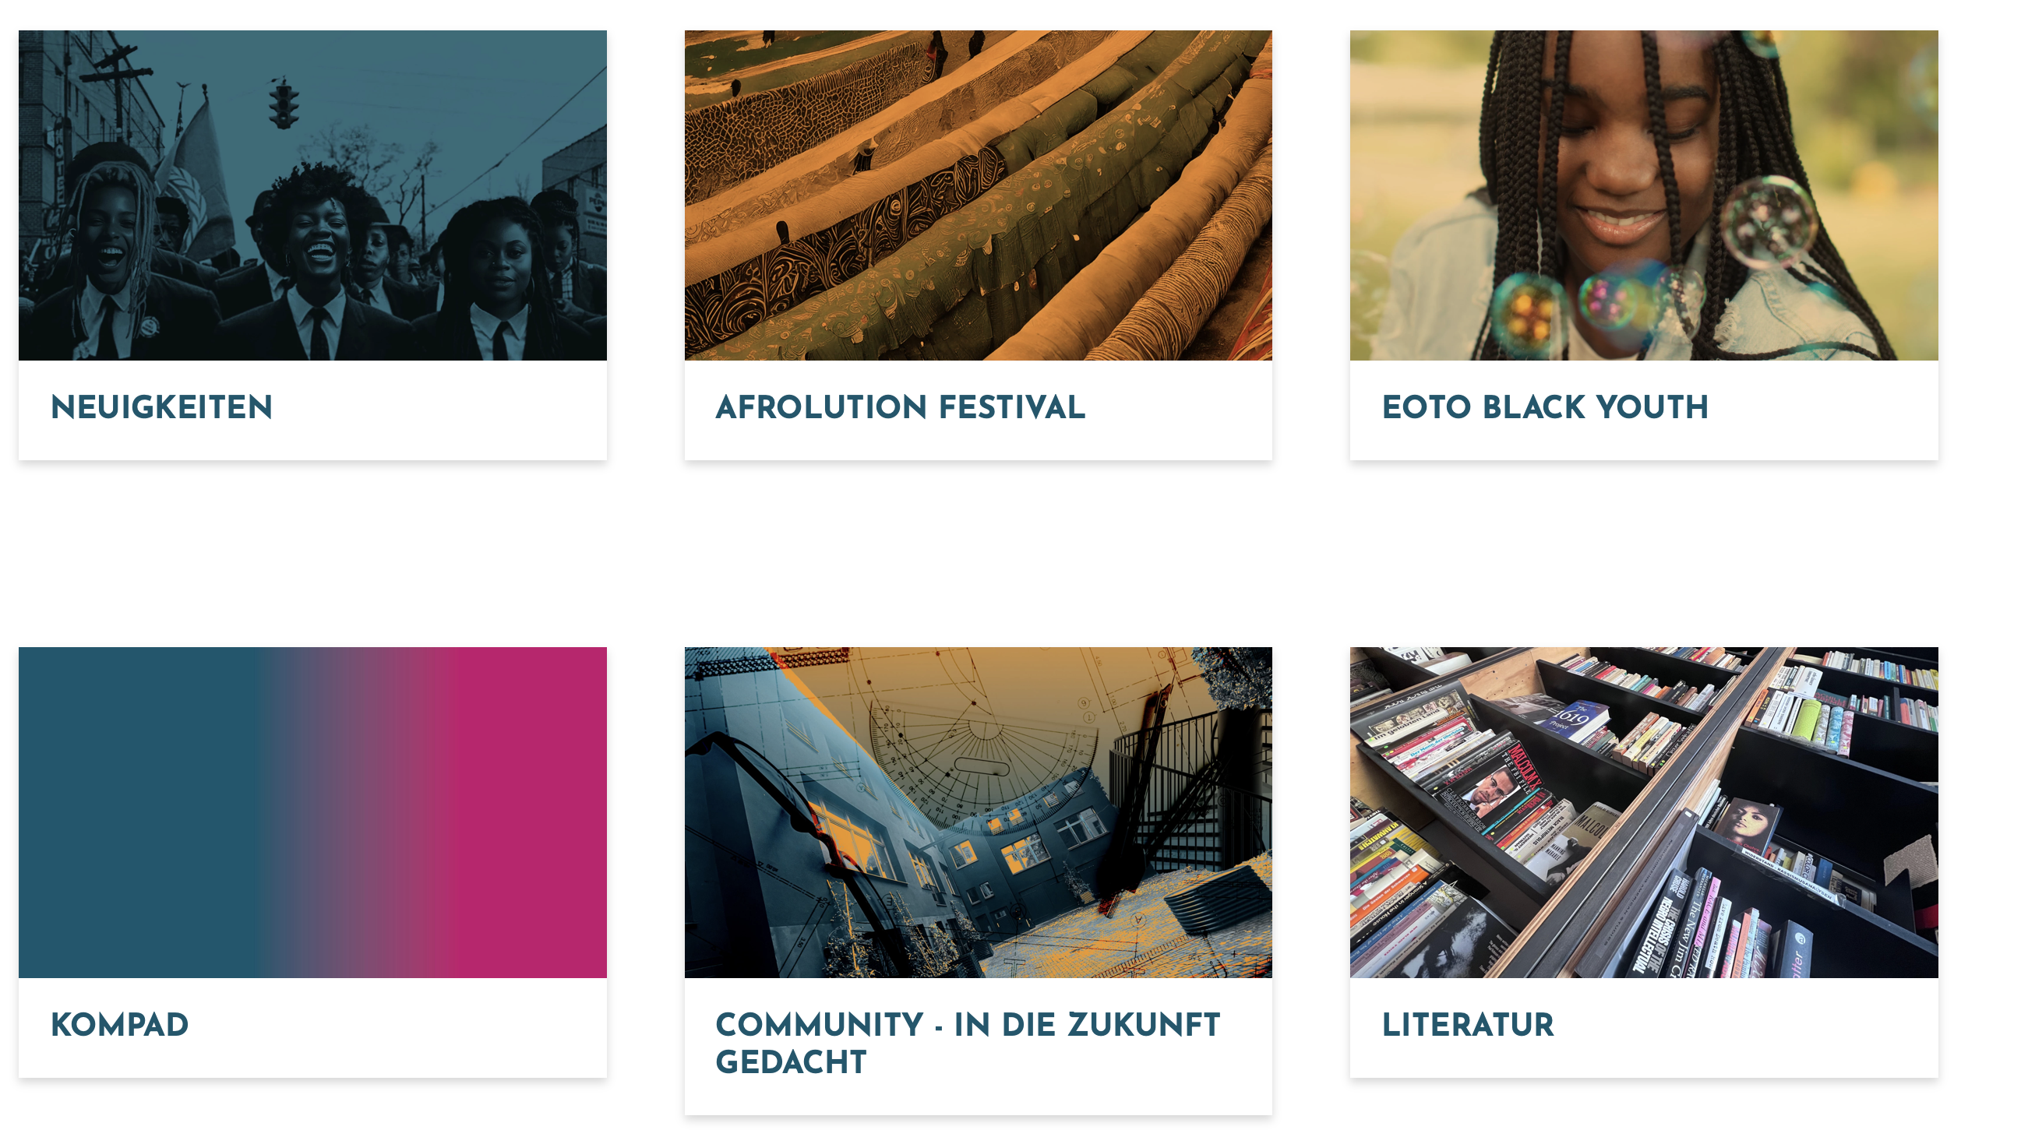

Slide 3
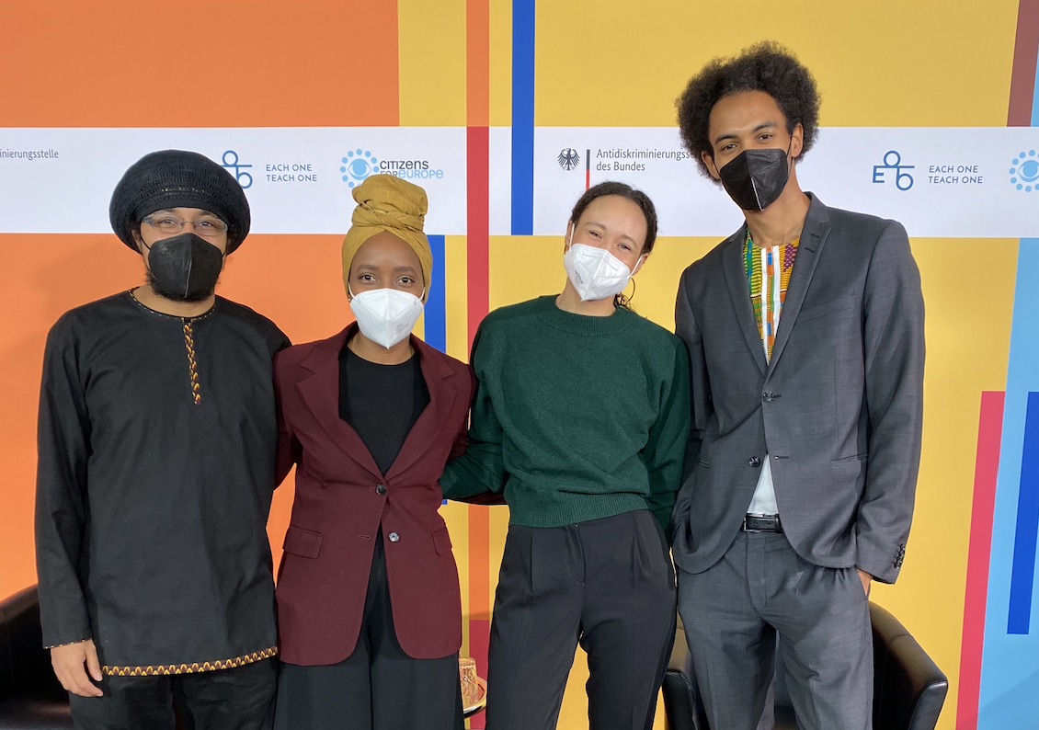

Slide 4
"Blackness is a cypher, where the conversation is intergenerational, international and interdependent."
Minna Salami (2020, p. 92)
Notes:
"It is part of the knowledge base within Black communities that anti-Black racism structures German society."
Within Germany's academia, politics, and civil society, Black perspectives remain underrepresented, leading to an absence of debates founded on Black experiences and analyses.

Slide 5
German Colonialism and Nazi eugenics:
  German colonizers committed the first genocide of the 20th (1904 - 1908)
    killed many thousand Herero and Nama in today’s Namibia
      (Olusoga & Erichsen, 2010; Zimmerer & Zelle, 2008)
  Nazi policies of “racial hygiene” systematic murder of millions of people during the Holocaust (Mohsen, 2020).
Notes:
Racism in Germany cannot be understood without reviewing the history of (European and) German colonialism in Africa (El-Tayeb, 2001; Kilomba, 2008; Oguntoye et al., 1992).
Colonial construction of supposed biological superiority of white European
German occupation of territories in Togo, Cameroon, “German East Africa”, and “German South West Africa”

Slide 6
Continuities of racialization, race-evasive discourse and science
  Race-evasive approaches displace racism temporarily, socially and geographically (Bojadžijev et al., 2017).
  Replacement of the term "Rasse” in the German constitution
  Proxies to study racism: migration background, foreigners, culture etc.
Notes:
Thus, racism is tied to the National Socialist racial policiesy, or linked to right-wing extremism or treated as a problem of former colonialist powers such as Britain and France
Racism is historically tied by scientific theories of white superiority and racial purity
German society avoided discussing race and racism for several decades
anti-Semitic and racially motivated terrorist attacks in Halle (2019), and in Hanau (2020)

Slide 7
49%
of the German population still believe in the existence of "human races”
biologistic categorizations and cultural hierarchies
(DeZIM, 2022)
Notes:
Recent surveys indicate racist beliefs persist in a significant portion of the German population, including biologistic categorizations and cultural hierarchies.
this also in the legitimization of social inequalities are found in 33–50% of the German population
Racist Realities
How does Germany deal with racism?
Racist bodies of knowledge and ideas are to some extent deeply rooted in society. 49% of respondents believe that human "races" exist, although this has long been scientifically refuted.
Every second to third person surveyed sees biological differences between people or judges people on the basis of their "culture".

Slide 8
Race is not real – but it is real in its consequences!

Slide 9
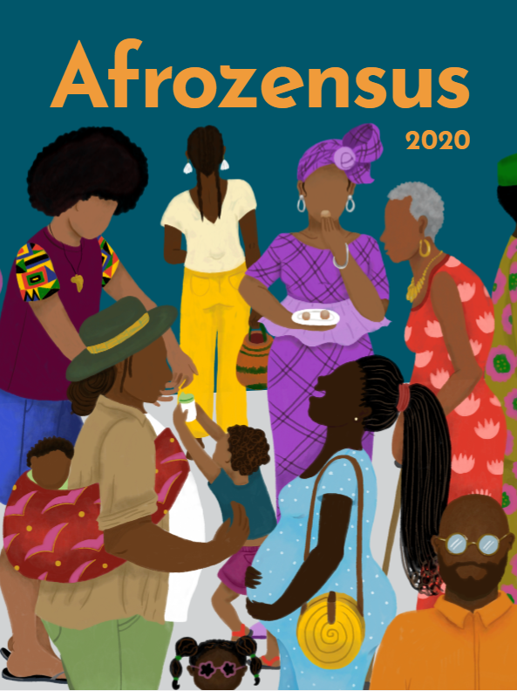
Notes:
Large-scale study that scientifically records the realities of life and (discriminatory) experiences of Black, African and Afro-diasporic people in Germany from a racism-critical perspective
Empowerment of communities: What does Black life in Germany look like and what needs must Black organizations address?
Creating a data basis for demanding political measures to combat and reduce anti-Black racism & promoting equality and empowerment
The Afrozensus shows: "The problem is structural, not personal"
Validating the individual and collective experience of Black, African and Afro-diasporic people - empowerment against the feeling of isolation

Slide 10
Communities-led Research – Afrozensus
Perspectives, Engagement and Experiences of Anti-Black Racism of Black, African and Afrodiasporic people in Germany
Filling the (quantitative) gap:
Communities-led Research Project driven by Black communities activism, social movements and scholar activism.
Do-no harm policy to approach communities
Communities data ownership and monitoring

Slide 11
Afrozensus - Approaches
Methodological approach: Numbers do not explain mechanisms:
  quantitative (online questionnaire) and
  qualitative research (focus groups and expert interviews)
Theoretical approach: critical, emancipatory, based on Black and African, feminist and decolonial approaches

Slide 12
Afrozensus - Online Survey
  Survey period: July to September 2020
  “Hidden & hard to reach”: hard to reach for whom?
  Snowball sampling by self-identification
  Cooperation and Outreach with 15 Black organizations
  well-known Black individuals and other organizations (e.g. anti-discrimination agencies)
  6.419 Participants (before data cleaning)
  5,793 Total participants
Notes:
hard to reach

Slide 13
Core principles for collecting anti-discrimination and equality data
Self-identification
Voluntary participation
Clarity about the purpose of data collection
Anonymity of respondents
Participation of representatives of marginalized groups in the process of data collection, analysis and dissemination
Intersectional analysis multiple identities, grounds for discrimination
Principle of non-harm (data must not be misused)

Slide 14
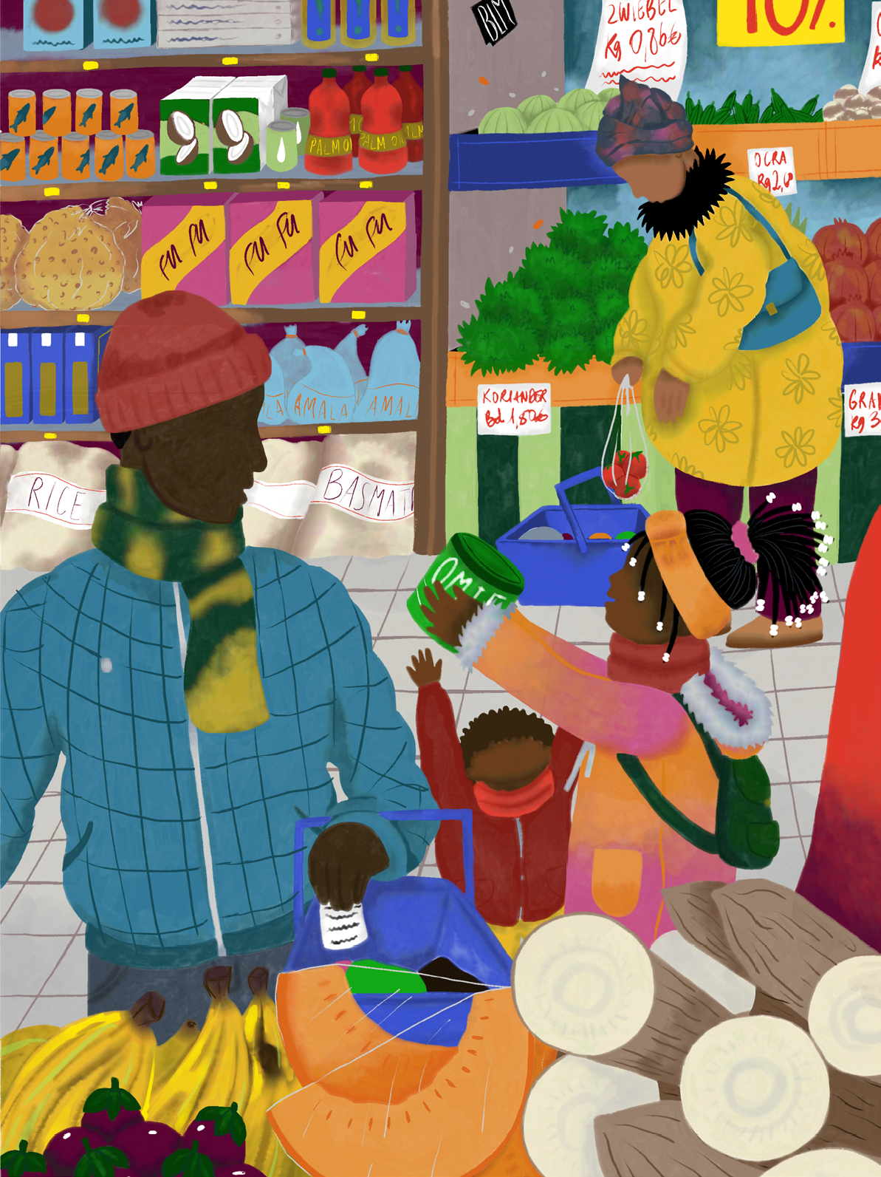
Two central premises of the Afrozensus:
Black communities are inherently diverse and simultaneously have shared experiences.
Anti-Black racism is characterized by very specific racist attributions and patterns experienced by Black, African and Afro-diasporic people in Germany and globally.

Slide 15

Diversity Dimensions
Gender identity(ies)
Sexual orientation/identities
age
Place of residence (urban/rural; east/west)
Disability and/or impairment
Religious affiliation in relation to anti-Muslim racism
Nationality
Refugee experience
Migration background
education
income
Marital status in relation to single parents
Number of African/afro-diasporic parents
Notes:
ab hier Teresa
Fett = haben die meisten signfikanten und größten gruppeninternen Unterschiede in Bezug auf Diskriminierungserfahrungen
Deniz: wenn die fett markierten signifikant sind, dann sollten sie auch oben als Gruppe einmal beannt werden, aber ihr habt behinderung ausgebldnet?

Slide 17
97,3%
experienced Anti-Black Racism
Notes:
Independent of their assessments of the general prevalence of anti-Black racism in Germany, nearly all (97.3%) of AfroCensus respondents (n = 4308) indicate that they personally experience ASR. Nearly half of respondents (42.9%) also report experiencing anti-Black racism "often" or "very often."

Slide 18
Anti-Black Racism – Patterns and Dynamics
    Processes of othering
    (Hyper-) sexualisation
    Criminalisation
    Qualifications and skills not being recognised or questioned
    De-individualisation and homogenisation
    Denial of ABR experience

Slide 19
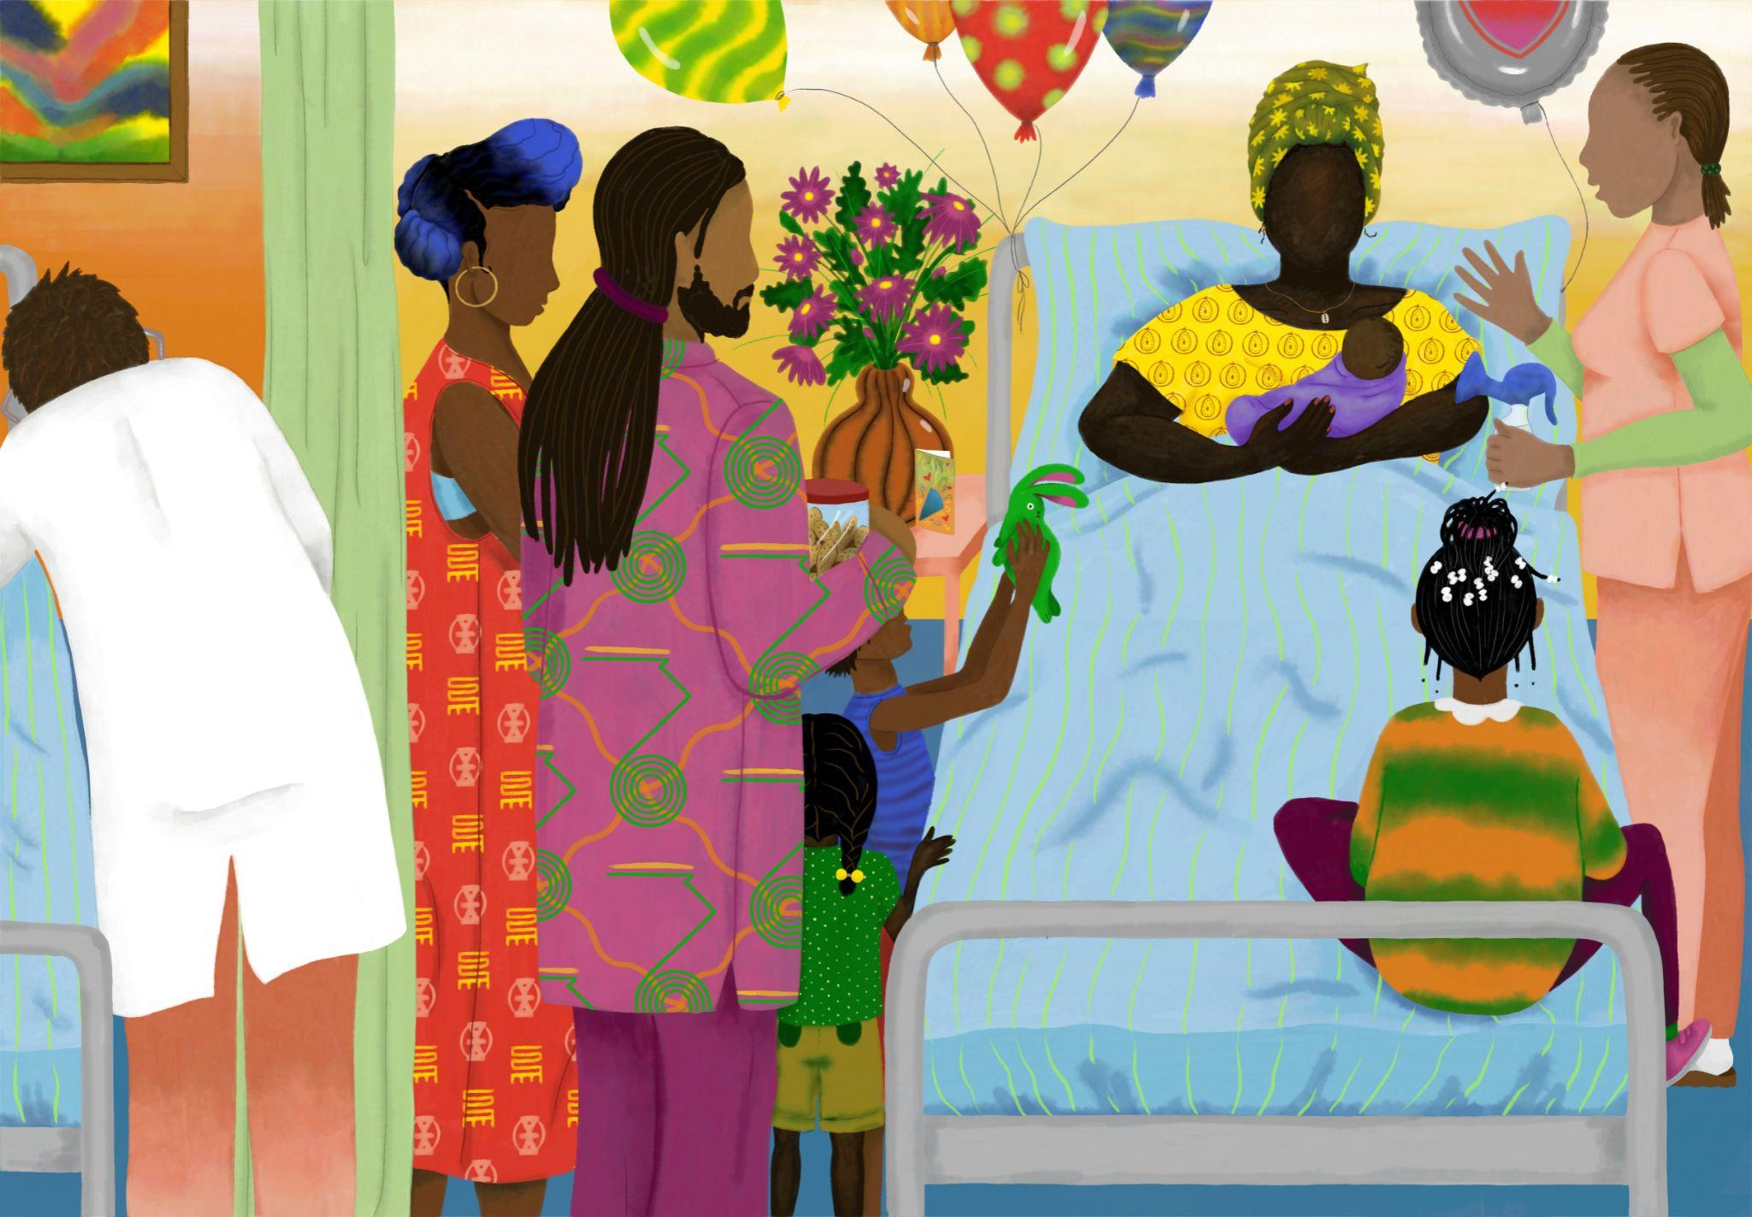

Slide 20
Dual exclusion mechanism:
  Discrimination in the utilisation of care as well as through non-utilisation, i.e. anticipated discrimination due to avoiding care structures.
  Racist aggression or violence in the provision of care exacerbates structural deficits.
Notes:
Cancellation and delay of treatment or therapy

Slide 21
Notes:
Racist Realities
How does Germany deal with racism?
Racist bodies of knowledge and ideas are to some extent deeply rooted in society. 49% of respondents believe that human "races" exist, although this has long been scientifically refuted.
Every second to third person surveyed sees biological differences between people or judges people on the basis of their "culture".

Slide 22
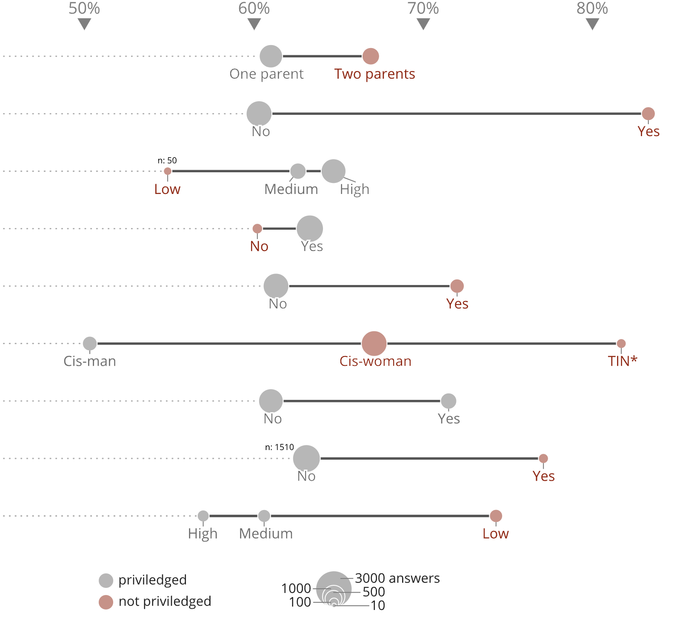
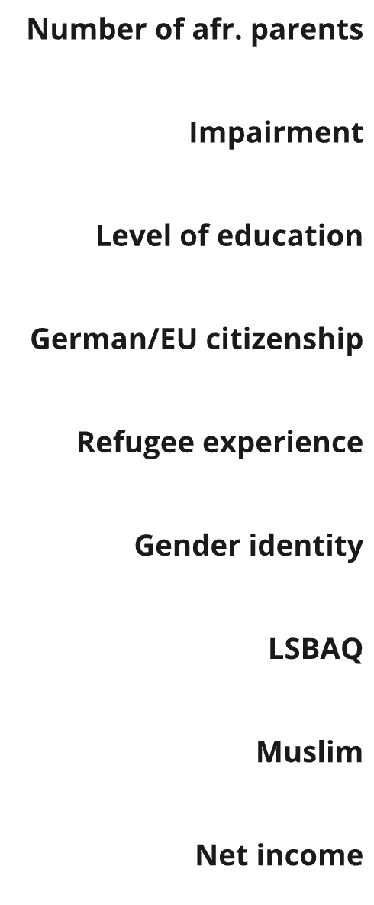

Slide 23
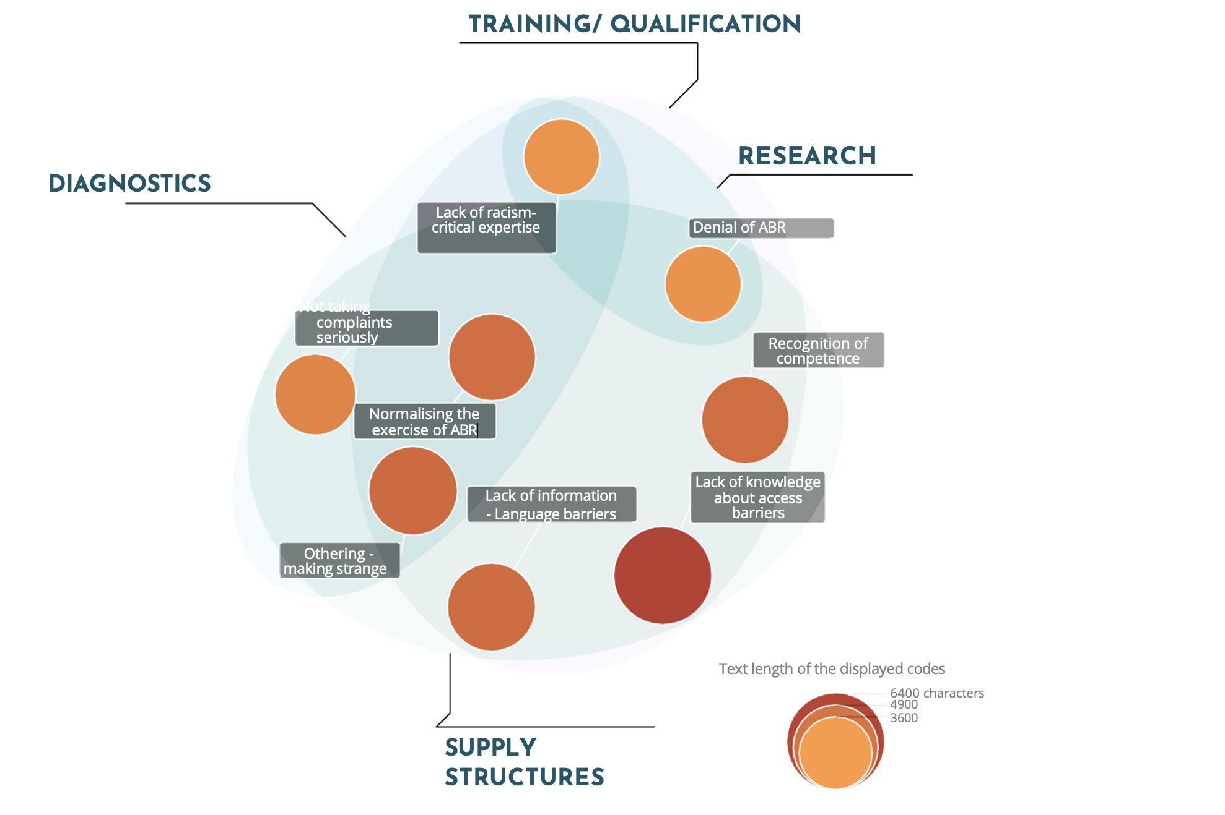
Notes:
Anti Black Racism manifests in general health care structures as well as:
diagnostics, research, and in education and qualification

Slide 24
Yes 66,7%
EOTO & CFE, CC BY-NC-ND 4.0 | afrozensus.de
Notes:
Intersections: Gender, SES, colorism

Slide 25
Yes 66,7%
EOTO & CFE, CC BY-NC-ND 4.0 | afrozensus.de

Slide 26
98%
n = 4339 assume that discrimination occurs in the area of "health and care”
14.7% state that they have avoided the health care system in the past two years for fear of discrimination.
Notes:
Cancellation and delay of treatment or therapy
Avoiding the health care system: 14.7%
worsens medical conditions
high structural access barriers and racist experiences
especially in context of psychotherapeutic and psychiatric healthcare avoidance and delay of essential treatment is being reported

Slide 27
Consequences
Discontinuation and delay of treatment or therapy
Avoidance
Mental stress / burden
Additional costs
Notes:
Demand: examine - Effects of Racism on Health!

Slide 28
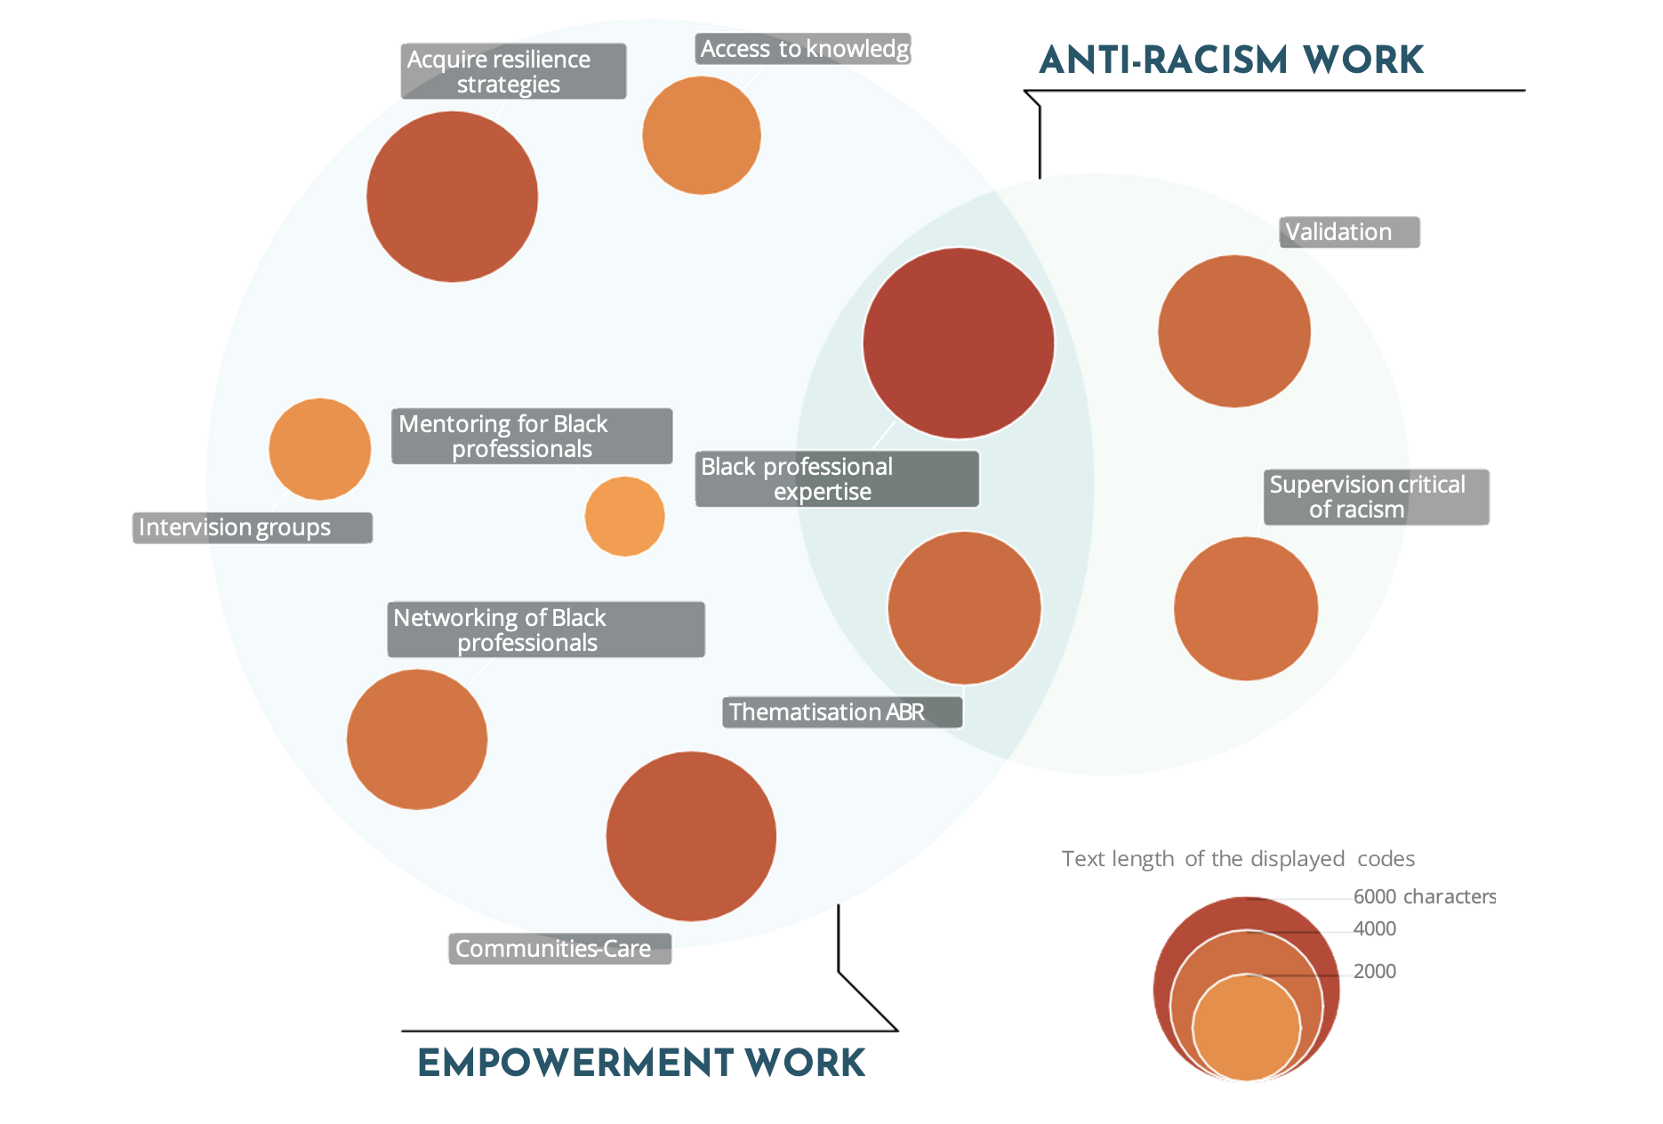
Notes:
health professionals experiences

Slide 29
Recommendations for action for politics and administration
Address racism in its structures and institutions, develop expertise that is critical of racism and understand racism as a significant factor impacting the health of Black people.
Psychotherapeutic care: special needs / therapists with racism-critical skills and competencies
Systematically promote access to medical training specifically for black people
Evaluation of current treatment concepts and training programs
Notes:
Demand: examine - Effects of Racism on Health!

Slide 30
Recommendations for action for Black, African and Afro-diasporic communities
Sharing knowledge: too few self-organized spaces in which Black, African and Afro-diasporic communities and self-organizations can share information about navigating the health care system.
Complaints mechanisms: Black individuals and associations have so far made too little use of official complaints mechanisms
  → demands and needs to the medical associations and psychotherapeutic institutions.
Notes:
Demand: examine - Effects of Racism on Health!

Slide 31
Research on Racism and Health in Germany
Study racial disparities: German health care system and effects of racism on health.
Race-evasive approaches are dominant
History of medical research is based on violence - historical events have had a lasting impact on marginalized communities
German Science lacks both lack of differentiated concepts and data
Examining race and the processes of racialization and its effects on health
Notes:
racial essentialism – scienfic racism

Slide 32
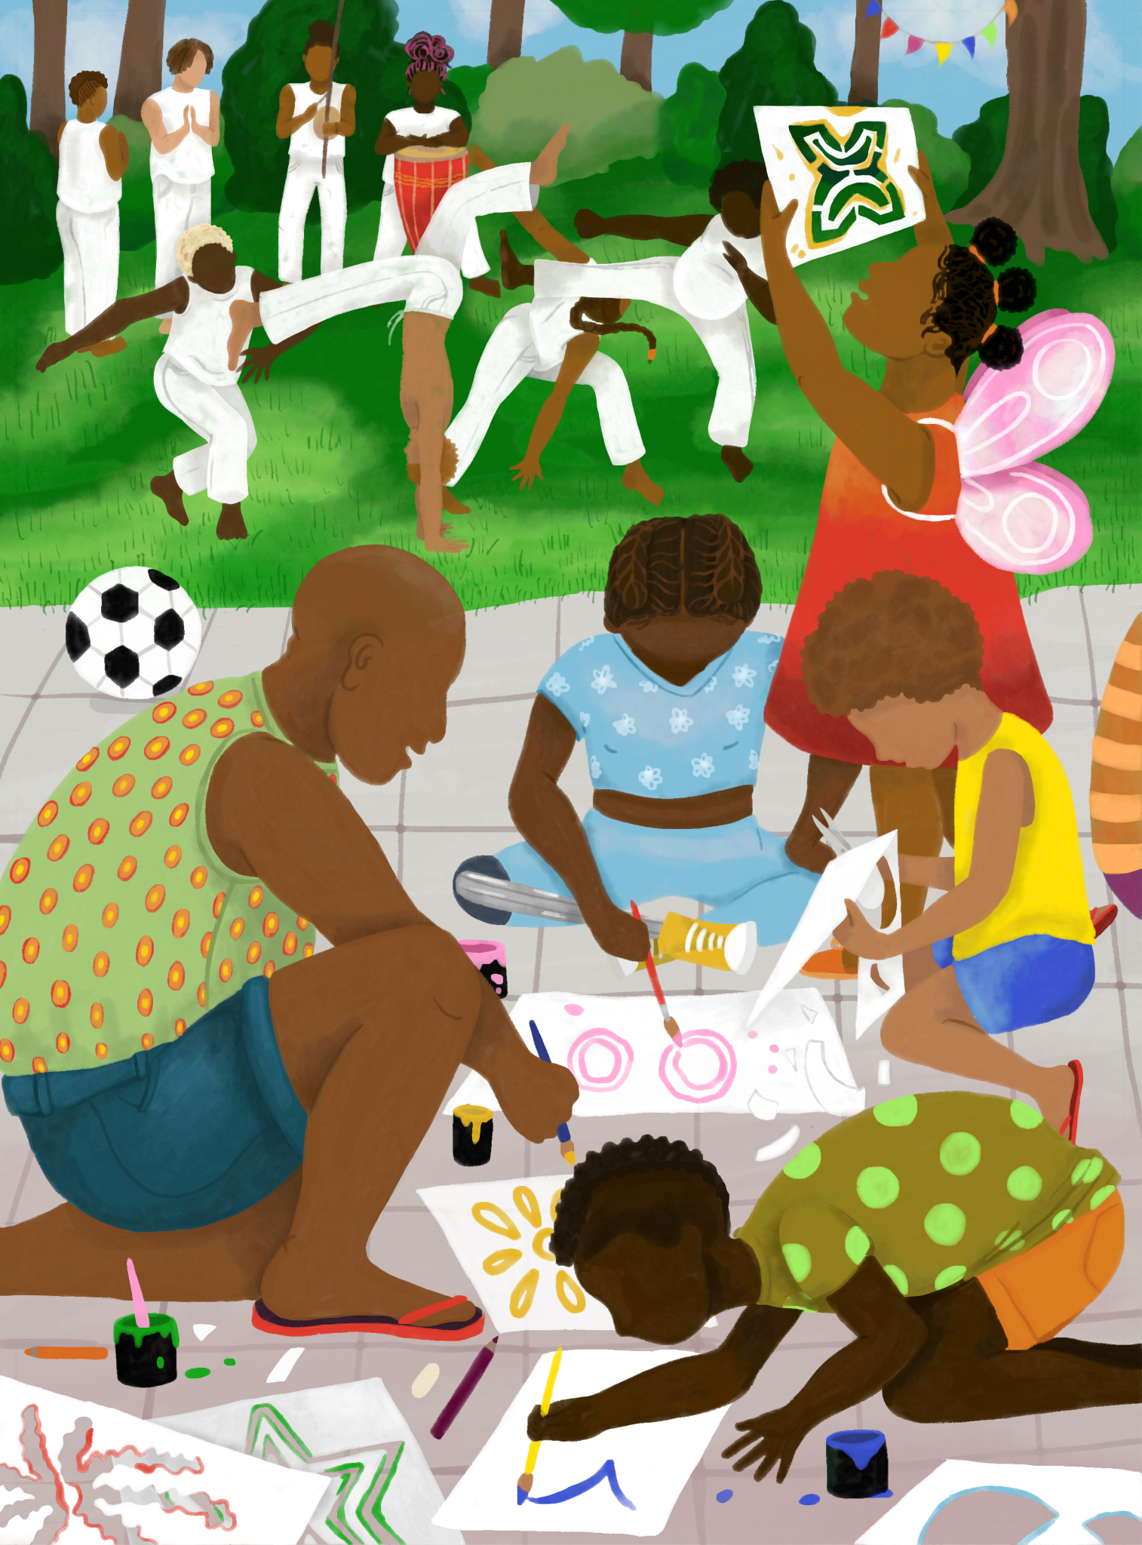
"Black empowerment, enlightenment, networking, education, new terminologies that can give a name to what is experienced and thus make it real and also tangible for others.”
______
"Indeed, there is knowledge. Indeed, there is experience."
"[This knowledge] however, is not being recognised to matter."
Notes:
knowledge mobilisation

Slide 33

EOTO & CFE, CC BY-NC-ND 4.0 | afrozensus.de

Slide 34
Self-positioning
Notes:
Resistance and sources of empowerment

Slide 35
"Anti-Black Racism (ABR) is a specific form of racism and has been a tradition in Europe and Germany since the time of enslavement. ABR is a specific degradation, dehumanisation and racist discrimination of Black people of African descent. Regardless of the reality of discrimination/hierarchisation according to 'skin tone' (colourism), ABR cannot be reduced to discrimination based on 'skin colour', as specific dynamics exist in anti-Black discrimination, and these are experienced by people of different 'skin tones'."

